Slide 1
System Software and Computing Concepts
CT123-3-1Ver: VDE
0005 - CPU & Memory

Slide 2
Defined The Course
2. Learning Outcomes
At the end of this topic, YOU should be able to
Describe the structure, components and functions of a computer system.
1. Topics We Will Cover
CPU Components
The Concept of Registers
The Memory Unit
Fetch-Execute Cycle
Buses
Instructions and Word Formats

Slide 3
Story Line
2. RAM (Random Access Memory)
Description: RAM is short-term memory where the CPU temporarily stores files and programs that are actively in use. It’s much faster than the hard drive, but it can only hold data while the computer is running.
Analogy: RAM is like the desk in your office. The amount of free space on your desk determines how many items (books, files, etc.) you can work on simultaneously. Once your desk is full, you can’t add more without removing something.
Example: When you open the VLC media player, it gets loaded into RAM, where it runs. You also load your MP3 file into RAM while it plays. If you want to open another application, like a web browser, it also gets loaded into RAM, but eventually, RAM will run out of space.
Let's break down the components of the computer system you've mentioned, using a technical yet approachable explanation with examples and analogies where possible. Afterward, I'll illustrate the architectural diagram conceptually, using your analogy of the kitchen as a guide.
1. Hard Drive (Storage)
Description: The hard drive (HDD or SSD) is the computer's long-term storage system. It holds all the data and programs even when the computer is turned off.
Analogy: Think of the hard drive as your "bag" when you're in an office. You store your tools, books, files, and other important items in the bag. Even though everything is in the bag, you can’t use them until you take them out and place them on your desk.
Example: A media player software like VLC and your favorite MP3 song are both stored on the hard drive. The files remain safe there even when the computer is off.

Slide 4
3. Cache Controller (CC)
Description: The cache controller manages the flow of data between the CPU and the Cache. It ensures that the most frequently accessed data is quickly available to the CPU from the cache memory instead of fetching it from slower storage or RAM.
Analogy: The cache controller is like a kitchen assistant who helps the chef (CPU). It makes sure that the ingredients (data) the chef needs most often are within arm's reach, cutting down on the time it would take to retrieve them from the pantry (RAM).
Example: If you're constantly using certain data, like a loop in a program or frequently accessed variables, they are stored in cache memory for faster access.
4. Cache (C)
Description: Cache memory is a smaller, faster type of memory located closer to the CPU. It stores copies of frequently accessed data from RAM to improve the speed of processing.
Analogy: Cache is like having a small counter near the chef (CPU) where ingredients are kept for quick access. Instead of the chef walking back and forth to the fridge (RAM) every time they need something, the assistant (cache controller) places frequently used ingredients (data) right on the counter (cache).
Example: When a web browser accesses a frequently visited website, parts of the website (like images) are stored in the cache. This allows the site to load faster the next time you visit.

Slide 5
5. CPU (Central Processing Unit)
Description: The CPU is the brain of the computer. It processes instructions from programs, performs calculations, and manages data flow between other components.
Analogy: The CPU is the chef in the kitchen. It reads the recipe (program instructions) and executes them step by step, transforming the ingredients (data) into the final dish (output).
Example: When you play an MP3 file, the CPU processes the instructions from the VLC media player, fetches the music data, and sends it to the speakers for playback.
5A. Inside the CPU
Control Unit (CU):
Description: The CU directs operations in the computer, fetching and decoding instructions from memory, and signaling other parts of the CPU to perform tasks.
Analogy: The CU is like a kitchen manager who tells the chef what to do next. It coordinates the steps in the cooking process.
Example: When executing a program, the control unit determines the next instruction to execute, such as "add" or "move data."
Arithmetic Logic Unit (ALU):
Description: The ALU performs arithmetic and logical operations such as addition, subtraction, and comparisons.
Analogy: The ALU is like a knife or cooking tool that performs the actual cutting, measuring, or mixing based on the recipe’s instructions.
Example: The ALU handles operations like comparing two numbers or adding values from different registers during a program’s execution.
Registers:
Description: Registers are small, high-speed storage locations in the CPU that temporarily hold data and instructions.
Analogy: Registers are like small bowls on the kitchen counter that hold ingredients (data) ready to be used by the chef (CPU).
Example: When a program needs to add two numbers, those numbers are stored in registers for immediate access by the ALU.

Slide 6
6. Input/Output (I/O) Devices
Description: I/O devices allow the computer to communicate with the outside world. Input devices (keyboard, mouse, etc.) allow you to give instructions to the computer, while output devices (monitor, printer, speakers) allow the computer to display or output information.
Analogy: I/O devices are like the kitchen’s oven or stove, allowing you to perform tasks like heating or mixing and then displaying the results (a cooked dish).
Example: When you press a key on the keyboard (input), the CPU processes that and displays the corresponding character on the screen (output).
Diagram Breakdown (Verbal Description)
Hard Drive (Storage) is where all files and programs live when not in use.
When you want to use a file or program, it’s loaded from the Hard Drive into RAM (working memory).
The Cache Controller manages the transfer of frequently used data from RAM into Cache for faster access by the CPU.
The CPU (which includes the Control Unit, ALU, and Registers) uses the data and instructions in Cache to perform tasks, moving between RAM and Cache as needed.
Input from the user (e.g., via I/O devices) is processed by the CPU, and the output (e.g., sound or video) is sent back to I/O devices.
This forms the core of traditional computer architecture.

Slide 7
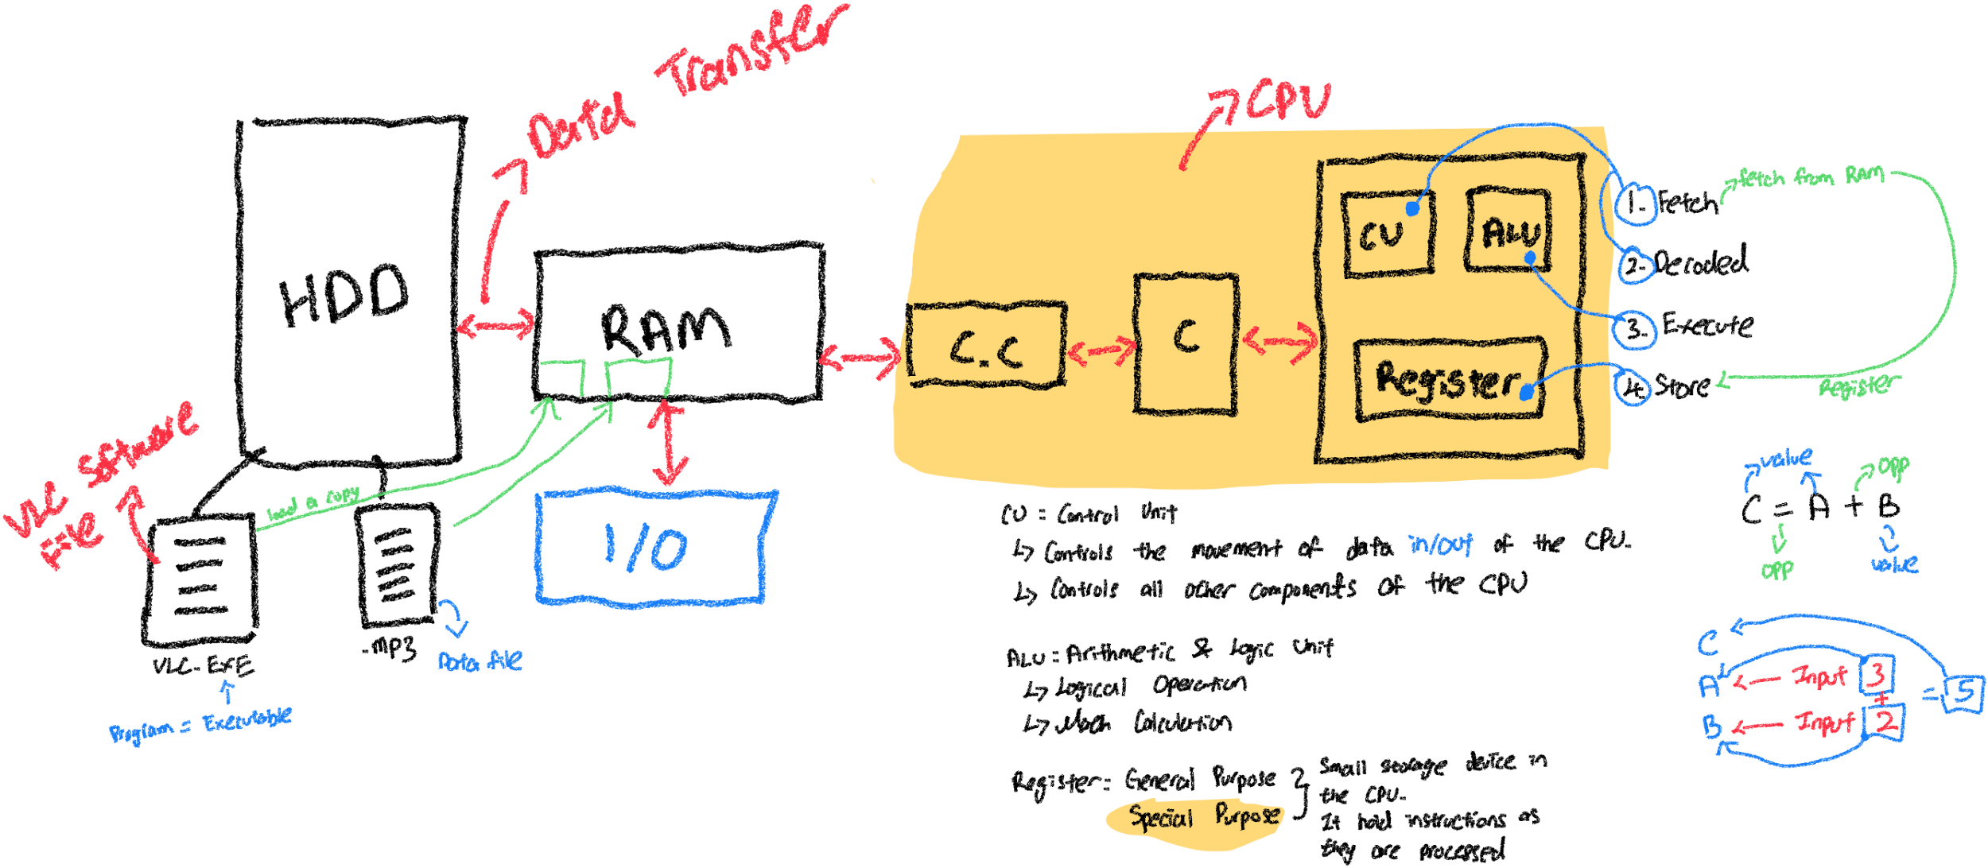

Slide 8
Let's go deeper into the CPU's core functions (Fetch, Decode, Execute, Store) and how the control unit (CU), arithmetic logic unit (ALU), and registers come into play. We’ll keep using the kitchen and chef analogy to break it down, so it’s easy to relate to real-world tasks. Along the way, we’ll detail each step with examples to paint a full picture.
1. Detailed Breakdown Of The Cpu Process
1A. Fetch (Step 1)
Description: The CPU first needs to "fetch" an instruction from memory (RAM) before it can do anything. This instruction could be something simple like “add two numbers” or “load data.”
Analogy: Imagine the chef in a kitchen with a recipe book (which is the program or instructions). The first thing the chef does is read the first line of the recipe. This is the "fetch" phase: grabbing the instructions from the recipe book.
Example: Let’s say the CPU is running VLC media player, and it has an instruction to "play an MP3 file." The CPU fetches this instruction from RAM, just like the chef fetching the first line from the recipe, which says "Preheat the oven."
1B. Decode (Step 2)
Description: After fetching the instruction, the CPU must "decode" it. The decoding process is all about understanding what the instruction means—what kind of operation needs to be performed (e.g., addition, subtraction, etc.).
Analogy: After reading the first line of the recipe, the chef needs to understand what it means. For instance, if the recipe says, "preheat the oven to 180°C," the chef needs to know how to turn on the oven and set it to 180°C.
Example: After fetching the instruction to "play the MP3 file," the CPU decodes it and understands that it needs to read the audio data and send it to the speakers.

Slide 9
1C. Execute (Step 3)
Description: Once the instruction is decoded, the CPU executes it. This is where actual processing takes place. For instance, if the instruction was to add two numbers, the CPU will perform that addition.
Analogy: Now that the chef knows the instruction, it's time to perform the task. If the decoded instruction was "preheat the oven," the chef will walk over and turn the oven knob to 180°C. This is the execution phase.
Example: The CPU begins executing the instruction to play the MP3 file. It sends chunks of the audio data to the speakers in real time.
1D. Store (Step 4)
Description: After executing the instruction, the result is typically stored back in memory or registers. This could be storing a calculated value or a completed operations result.
Analogy: After the chef preheats the oven, they might need to store the information that the oven is now ready for baking. In a real scenario, after chopping an ingredient, the chef places it in a bowl (storage) for later use.
Example: After decoding and executing the instruction to play music, the CPU stores the current playback position in RAM, so it knows where to resume from if paused.

Slide 10
2. Components Of The Cpu And Their Functions
2A. Control Unit (CU)
Description: The CU is responsible for controlling the flow of data inside the CPU. It handles the fetching and decoding stages and decides how other parts of the CPU will act. It essentially coordinates all operations.
Analogy: The control unit is like a kitchen manager that organizes the chef's work. The manager tells the chef (CPU) what to do, when to fetch ingredients, and how to perform each step in the recipe.
Example: When VLC media player tells the CPU to "play the MP3," the CU interprets this and decides which components should be involved in playing the file.
2B. Arithmetic Logic Unit (ALU)
Description: The ALU is the part of the CPU that performs all arithmetic (like addition, subtraction) and logical (like comparisons) operations. If the program requires any calculations or decisions (e.g., is a number larger than another?), the ALU handles it.
Analogy: The ALU is like the chef's tools (knife, measuring cups, etc.) used to perform tasks like chopping vegetables (logical operations) or measuring ingredients (arithmetic operations).
Example: If you’re adjusting the volume of an MP3 file in VLC, the ALU calculates how much to increase or decrease the volume by.

Slide 11
2C. Registers
Description: Registers are small storage areas inside the CPU used to temporarily hold data that the CPU is currently working on. They are much faster than RAM, but hold less data.
Analogy: Registers are like the chef’s hands and small bowls. While the chef is working, they can only hold or carry a few items at once. They grab a pinch of salt or hold a measuring cup with flour. These are small amounts of ingredients used immediately in the cooking process.
Types of Registers:
General Purpose Registers: Can store any kind of data the CPU is currently processing, like temporary results from calculations.
Special Purpose Registers: These have specific jobs, like the Program Counter (which tracks the next instruction) or the Accumulator (which holds results of calculations).
Example: Suppose the CPU needs to add two numbers—both numbers will first be loaded into registers. After the ALU adds them, the result might also be stored in a register temporarily before being written back to RAM.
3. How It All Works Together (With Analogy)
Loading VLC and MP3:
The VLC executable is loaded into RAM from the Hard Drive, similar to the chef fetching both the recipe and ingredients from the store and placing them on the kitchen counter.
The CPU, like the chef, needs to fetch the first instruction from the recipe (VLC) that says, "Play MP3." The instruction tells the CPU what ingredients (data) are needed (the MP3 file).
Fetching and Executing:
The CPU begins by fetching the instruction from the VLC program to play a song. It decodes the instruction, understanding that it needs to load the MP3 file into memory and play it.
The CPU then executes the instruction by sending audio data to the speakers, much like the chef preparing the dish.

Slide 12
Managing Data:
While the music plays, the CPU constantly fetches and executes instructions from VLC, like adjusting playback or handling user inputs (e.g., clicking "Pause").
The ALU would perform arithmetic tasks, like adjusting volume or equalizing sound, much like a chef using tools to make precise cuts or measurements.
Throughout this process, the registers hold small pieces of data, such as the current playback time or sound sample being processed, similar to a chef holding small ingredients or using bowls to mix.
Recap Of The Kitchen Analogy
Chef (CPU): The worker who performs all tasks.
Recipe (Program): The instructions that tell the chef what to do (the VLC application or MP3).
Ingredients (Data): The files and information the chef uses to make the dish (MP3 file, volume control settings).
Hands (Registers): Small storage areas that hold instructions and data during processing.
Oven/Tools (ALU): The devices used for performing actions, like logical decisions or arithmetic operations.
This system allows the CPU to efficiently fetch, decode, execute, and store instructions to run programs smoothly!

Slide 13
Let's walk through the process of fetching, decoding, executing, and storing the result of a simple program, like the one you're describing, step by step with examples, and explain how the Control Unit (CU), Arithmetic Logic Unit (ALU), and Registers play their roles.
1. Overview Of The Instruction: C = A + B
This simple instruction in C programming language (C = A + B) tells the computer to:
Create variables C, A, and B.
Add the values of A and B.
Store the result in C.
We’ll now break this process into the four CPU operations: fetch, decode, execute, and store.
1A. Fetch the Instruction
What happens? The CPU begins by fetching the instruction C = A + B from RAM and loading it into a register (a small, fast storage location within the CPU).
CU's Role: The Control Unit is responsible for managing the fetch operation. It fetches the instruction from RAM and places it into a register, which temporarily holds the instruction.
Analogy: Imagine the chef (CPU) has just read the next step in the recipe: “Add two ingredients and store the result.”
Example:
The program is in memory (RAM), so the CU reads and fetches the instruction C = A + B. This means the CU now knows that the next operation involves creating three variables and performing an addition.

Slide 14
1B. Decode The Instruction
What happens? The CPU then decodes the fetched instruction. In our case, the instruction C = A + B is decoded by the CPU to understand that:
The CPU needs to create space for three variables: A, B, and C.
The CPU needs to perform an addition (+) between A and B.
The result should be stored in C.
CU's Role: The Control Unit handles decoding. It interprets the fetched instruction to understand what needs to be done.
Analogy: The chef (CPU) is now reading the recipe and realizing they need to mix two ingredients. It’s not just about reading; they need to know exactly what actions to take with those ingredients.
Example:
After decoding, the CPU knows that C = A + B means:
It will need to perform an addition.
There are three variables (C, A, and B).
Values will be entered for A and B, and the result will be assigned to C.
1C. Execute The Instruction
What happens? The CPU executes the instruction by performing the arithmetic operation, i.e., adding the values of A and B. This is done using the Arithmetic Logic Unit (ALU).
ALU's Role: The ALU is responsible for carrying out the actual arithmetic operation (in this case, addition).
Analogy: The chef takes the ingredients A and B, adds them together, and prepares the result, ready to serve (or store in a bowl, which would be C).
Example:
Let’s say the user inputs the values A = 3 and B = 2:
The ALU adds A and B (3 + 2) to produce the result 5.
The ALU handles this arithmetic calculation and produces the result.

Slide 15
1D. Store The Result
What happens? After executing the instruction and generating the result, the CPU stores the result (5) in a register (specifically, the register that holds the variable C).
Registers’ Role: Registers temporarily hold the values during processing. The result of the operation (5) is stored in the register assigned to C.
Analogy: The chef finishes mixing the ingredients and places the finished mixture (the result) into a bowl (register), ready to be used later.
Example:
After the ALU computes 3 + 2 = 5, the result 5 is stored in the register associated with C.
Now, if the CPU needs to access the value of C, it knows that the register holds the value 5.
2. Detailed Step-By-Step Breakdown Of The Process For C = A + B
Let’s walk through the entire process again with a clear timeline:
Fetching:
Action: The CU fetches the instruction C = A + B from RAM and stores it in a register.
Where?: RAM → Register.
Outcome: Instruction is now in the register, ready to be processed.
Decoding:
Action: The CU decodes the instruction and realizes it needs to:
Create variables C, A, and B.
Perform an addition between A and B.
Store the result in C.
Outcome: The instruction is understood. The CPU knows it needs to perform an addition and create storage for the three variables.

Slide 16
Executing:
Action: The CPU’s ALU performs the addition.
User inputs A = 3 and B = 2.
The ALU computes A + B = 3 + 2 = 5.
Outcome: The addition operation is completed, and the result (5) is produced.
Storing:
Action: The result (5) is stored in the register associated with C.
Outcome: The register holding C now contains the value 5, representing the result of the addition.
Summary Of Key Components
Control Unit (CU): Responsible for fetching and decoding the instructions. It controls the overall operation of the CPU.
Fetch: It grabs the instruction from RAM and stores it in a register.
Decode: It interprets what the instruction is asking the CPU to do.
Arithmetic Logic Unit (ALU): Executes arithmetic and logical operations.
Execute: It performs the addition of A and B in this example.
Registers: Small, fast storage locations inside the CPU that hold data and instructions temporarily.
Store: The result of the execution (5) is stored in the register assigned to C.

Slide 17
Example Of Another Instruction: X = Y * Z
For a multiplication instruction like X = Y * Z, the same process applies:
Fetch: The instruction is fetched from RAM and stored in a register.
Decode: The CPU decodes the instruction to realize it must multiply Y and Z and store the result in X.
Execute: The ALU performs the multiplication (Y * Z).
Store: The result is stored in the register associated with X.
In summary, the CPU’s process of fetching, decoding, executing, and storing is the heart of computing, where different components (CU, ALU, and registers) work together to process instructions and generate results step by step. Each part of the system is finely tuned to ensure efficient operation, just like a chef working in a well-organized kitchen.

Slide 18
A Kitchen Analogy To Understand Computer Memory And Storage Layers
Let’s break down the computer’s different layers of memory and storage using the kitchen analogy. Think of the computer as a kitchen where you (the CPU) are the chef. In the kitchen, you need to manage various tasks efficiently, and where you store and retrieve ingredients/tools affects your speed and productivity. Similarly, in a computer, where data and instructions are stored can greatly affect the speed of operations.
In this analogy:
CPU = The Chef (You)
Registers = Your Hands and Pockets
Cache = Kitchen Cabinets/Drawers
RAM = Kitchen Storage Room
Hard Drive = Supermarket
1. Registers = Your Hands And Pockets (Fast, Small Storage)
The registers are the smallest, fastest storage units inside the CPU. They are like the pockets on your shirt or your hands. When you're cooking, the tools or ingredients that you use most frequently are either held in your hands or stored in your pockets for easy access.
You don’t keep everything in your pockets because they are small, but anything you need right now should be there for quick access.
Size: Very small (can only hold a few items).
Speed: Extremely fast to access.
Example: Imagine you’re chopping vegetables. You hold the knife in your hand (register) because you are using it constantly, and maybe you have some salt in your pocket for seasoning.
Computer Analogy: Registers are used to store very small amounts of data or instructions that the CPU is currently processing. For example, while performing a calculation like C = A + B, the values of A and B are loaded into registers for immediate access.

Slide 19
2. Cache = Kitchen Cabinets/Drawers (Larger, Still Fast Storage)
The cache is larger than the registers, but still much smaller than RAM. The cache is like the kitchen cabinets or drawers near your workspace. When cooking, you store frequently used tools and ingredients like spatulas, pots, pans, or spices in these cabinets.
It takes a little more time to open a cabinet than to reach into your pocket, but it’s still much faster than going to a different room.
Size: Larger than registers but smaller than RAM.
Speed: Very fast, but not as fast as registers.
Example: When you need a frying pan, you open a drawer or cabinet and get it. It’s not in your hand like the knife, but it’s still close and accessible.
Computer Analogy: Cache stores frequently used data or instructions that the CPU might need again soon. For example, if you're running a program that frequently accesses a certain piece of data, that data will be stored in the cache so the CPU can access it quickly without going to the slower RAM.
3. RAM (Random Access Memory) = Kitchen Storage Room (Bigger, Slower Storage)
The RAM is much larger than both the registers and the cache, but it’s also slower to access. This is like the storage room in your kitchen. You keep larger quantities of ingredients like bags of flour, sugar, rice, or jars of spices in your storage room.
It takes more time to walk to the storage room and get these items than to reach into a cabinet, but it’s still faster than going to the supermarket.
Size: Larger than cache and registers.
Speed: Slower than cache but much faster than a hard drive.
Example: When you need more flour for baking, you go to the storage room, get the flour, and bring it back to the kitchen.
Computer Analogy: RAM stores programs and data that are currently in use. When you open a program on your computer, it’s loaded from the hard drive into the RAM so the CPU can access it quickly. For example, if you’re editing a document, the entire document is loaded into RAM while you work on it.

Slide 20
4. Hard Drive (Secondary Storage) = Supermarket (Large, Slow Storage)
The hard drive is the largest and slowest storage in your system. It’s like the supermarket where you store all your ingredients, tools, and supplies before you bring them home.
You only go to the supermarket when you need to restock ingredients or get something you don’t have at home. It takes a long time to drive to the store and bring things back, so you don’t want to make this trip often.
Size: Very large (stores everything you own).
Speed: Much slower than RAM, cache, or registers.
Example: When you run out of sugar or oil, you drive to the supermarket to buy more, which takes more time than grabbing it from the storage room.
Computer Analogy: The hard drive stores everything permanently, including the operating system, applications, and files. When you open a program or file, it’s loaded from the hard drive into RAM. For example, when you turn on your computer, the operating system is loaded from the hard drive into RAM so it can be used.
5. Multiple Cache Levels (L1, L2, L3) = Different Kitchen Cabinets (Fast, Slower, Slowest)
Some computers have multiple levels of cache (L1, L2, L3). This is like having different cabinets in your kitchen with varying levels of accessibility:
L1 Cache = Cabinet near your cooking station (very close and fast to access).
L2 Cache = Cabinet further away (takes a little longer to reach).
L3 Cache = Even further away, but still closer than the storage room.
Each level of cache is larger but slower than the one before it, and it's still faster than accessing RAM.

Slide 21
6. Complete Workflow: How the CPU Uses These Layers
Let’s now imagine you’re cooking a meal. This will help us understand how all these layers of storage work together in a computer.
Step 1: Fetching Ingredients from the Supermarket (Hard Drive)
You drive to the supermarket to buy all the ingredients you need for the week (hard drive). You bring them home and store them in the kitchen storage room (RAM).
Step 2: Moving Frequently Used Ingredients to Cabinets (Cache)
From the storage room, you take out the ingredients you’ll need today and put them in the kitchen cabinets (cache). For example, you take out some flour, sugar, and oil because you’ll use them for baking.
Step 3: Putting Immediate Tools in Your Hands (Registers)
While cooking, you put the spatula and knife in your hand (registers) because you’re using them immediately. These tools need to be ready at all times.
Step 4: Cooking (Processing)
As you cook, you may need to add more ingredients from the cabinets (cache) or even go to the storage room (RAM) for larger items like a big bag of flour.
If you run out of something completely, you’ll need to drive back to the supermarket (hard drive).

Slide 22
7. Why Do We Have Multiple Layers of Storage?
The reason we have multiple layers of storage is to balance speed and capacity:
Registers: Small and extremely fast but can’t hold much data.
Cache: Larger than registers and still fast but a little slower.
RAM: Much larger than cache but slower to access.
Hard Drive: Largest but the slowest, used for long-term storage.
Without these layers, your computer would be extremely slow. If the CPU had to fetch data directly from the hard drive for every operation, it would take a long time to process anything—just like if you had to drive to the supermarket every time you needed a pinch of salt.
8. Example Summary: Cooking a Cake
Registers: Your hands and pockets where you keep immediate tools (e.g., knife, spoon).
Cache: The kitchen cabinet where you keep frequently used items (e.g., flour, sugar, oil).
RAM: The storage room where you keep larger quantities of ingredients (e.g., a bag of flour, rice).
Hard Drive: The supermarket where all ingredients and tools are stored.
By using these different levels of storage, you can cook efficiently without wasting time going back and forth to the supermarket. Similarly, a computer uses registers, cache, RAM, and the hard drive to access data efficiently while performing tasks.

Slide 23
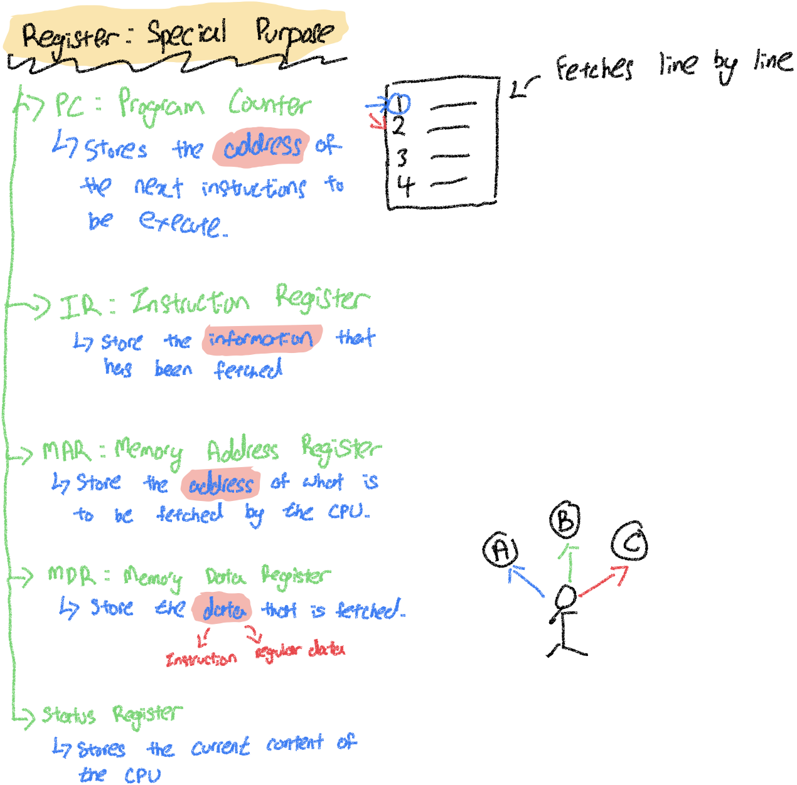

Slide 24
Differentiating Between General-Purpose Registers And Special-Purpose Registers
1. General-Purpose Registers (GPRs)
General-purpose registers are versatile storage units within the CPU that can hold any type of data, including numeric values, memory addresses, and instructions. These registers are not assigned to any specific task, so the CPU can use them flexibly depending on the program's requirements. They act like a regular bag that can carry almost anything—just like a plastic shopping bag that can hold food, clothes, or books.
Example Analogy: You go to the supermarket, buy groceries, and put them all into a general-purpose plastic bag. This bag can carry any item, whether it's bread, a bottle of milk, or a package of ice cream.
In the Computer: A general-purpose register may store a numeric value like 5, an address pointing to a memory location, or even a segment of a string. Its flexibility allows the CPU to optimize operations based on what the program is doing at any given time.
2. Special-Purpose Registers (SPRs)
Special-purpose registers are specifically designed to hold certain types of information critical to the CPU's operation. These registers are optimized for particular tasks, just like a thermal bag that’s specifically designed to keep your ice cream from melting. They store things like instruction addresses, fetched data, memory locations, or the status of the CPU.
Example Analogy: If you buy ice cream at the supermarket, you'll need a thermal bag designed to keep the cold in and the heat out. While a general-purpose plastic bag could carry the ice cream, it won't protect it from melting. The thermal bag is specialized for that task.
In the Computer: Special-purpose registers are used for very specific tasks. Each register has a predefined function, such as storing the next instruction address, the current instruction being executed, or the CPU’s status during computation.

Slide 25
3. Types of Special-Purpose Registers
Now let's explore five specific special-purpose registers and their roles, using examples and analogies to clarify how they operate.
3A. Program Counter (PC)
The Program Counter stores the address of the next instruction to be executed by the CPU. Think of it as a bookmark in a book. It doesn’t store the actual instruction but keeps track of where the CPU should fetch the next instruction from.
Analogy: Imagine you are reading a recipe book. After you finish cooking one dish (instruction), the program counter keeps your place in the book and reminds you of the next dish to cook.
In the Computer: If the CPU is processing instructions in a program located at address 1000, after executing the instruction at address 1000, the program counter will update to store the address 1001, pointing to the next instruction in the sequence.
3B. Instruction Register (IR)
The Instruction Register stores the actual instruction that has been fetched by the CPU. Unlike the program counter that stores the address, this register holds the instruction itself that the CPU will execute next.
Analogy: If the program counter is your bookmark, the instruction register is the actual page you are reading. It holds the specific recipe you’re following.
In the Computer: If the CPU fetches the instruction ADD A, B from memory, the instruction register will hold this specific instruction while the CPU decodes and executes it.

Slide 26
3C. Memory Address Register (MAR)
The Memory Address Register holds the address of the data that the CPU needs to fetch or store. It acts as a pointer to where the data is located in memory, but it doesn’t hold the actual data itself.
Analogy: Imagine you need to pick up ingredients from your kitchen cabinets. The MAR is like the note that tells you which cabinet contains the flour, but the note itself doesn’t hold the flour—it just tells you where to find it.
In the Computer: If the CPU needs to fetch data from memory address 5000, the MAR will store the value 5000, signaling to the memory unit where to go to retrieve the data.
3D. Memory Data Register (MDR)
The Memory Data Register (also called MDR or Data Register) holds the actual data fetched from or to be stored in memory. It works in tandem with the MAR: while the MAR provides the address, the MDR holds the actual data from that address.
Analogy: Continuing the kitchen example, after you find the flour at the specific cabinet indicated by the MAR, you place it on the countertop. The flour on the countertop represents the data in the MDR.
In the Computer: Suppose the data at memory address 5000 is 42. The MAR holds the address 5000, while the MDR will hold the value 42 once it's fetched.

Slide 27
3E. Status Register
The Status Register stores information about the current state of the CPU during operation. It keeps track of conditions like whether a calculation resulted in zero, an overflow occurred, or whether the CPU is in supervisor mode.
Analogy: The Status Register is like a notepad where you jot down details about how your cooking is going. If you're making a cake, the notepad might say, "The oven is at 350°F," or "The batter is mixed but not yet in the oven." This helps you track the status of each step.
In the Computer: Suppose the CPU just completed an addition operation. The status register will store the result’s flags, such as whether the result was zero (a Zero Flag) or whether an overflow occurred during the operation (an Overflow Flag).

Slide 28
4. Data vs. Instructions
To clarify the concept of data vs. instructions:
Instructions are commands that tell the CPU what to do (e.g., ADD, SUBTRACT, MOVE).
Data can be either an operand (a value used in an instruction) or the result of an operation.
For example:
An instruction might be ADD 5, 10 (add 5 and 10).
The data here is 5 and 10, while the instruction itself is ADD.
Both the instruction and the data need to be fetched, decoded, and executed by the CPU. The distinction lies in their roles: the instruction defines the operation, while the data provides the values to operate on.
5. Example Scenario: CPU Cycle Using Registers
Let’s walk through how these registers work in a CPU cycle:
Program Counter (PC): The PC stores the address of the next instruction, say 2000.
Memory Address Register (MAR): The MAR takes the address 2000 from the PC to fetch the instruction.
Instruction Register (IR): The instruction stored at address 2000 (e.g., ADD A, B) is fetched and placed in the IR.
Memory Data Register (MDR): If the instruction requires data (e.g., values for A and B), the MAR will fetch the addresses for A and B, and the MDR will hold their respective values.
Status Register: Once the instruction is executed (e.g., the sum of A and B), the Status Register might update flags like Zero Flag or Carry Flag depending on the result.
By breaking up the tasks across these special-purpose registers, the CPU ensures smooth and efficient operation. Each register has a unique and vital role, reducing the complexity of handling multiple operations at once.

Slide 29
CPU (Central Processing Unit): Major Components
The CPU is the primary component of a computer that performs most of the processing inside the system. It is often referred to as the "brain" of the computer, where calculations, data processing, and decision-making occur. The main components of a CPU include the Arithmetic Logic Unit (ALU), Control Unit (CU), and often several other subcomponents like Registers, Memory Management Unit (MMU), and I/O Interface.
1. Arithmetic Logic Unit (ALU)
The ALU is responsible for performing all arithmetic and logical operations. It processes mathematical functions such as addition, subtraction, multiplication, and division (arithmetic operations), as well as comparison functions like greater than, less than, and equal to (logical operations). It can also perform bitwise operations such as AND, OR, XOR, etc.
1A. Example
Addition: The ALU can add two numbers (e.g., 5 + 7 = 12).
Comparison: It compares whether one number is greater than another (e.g., 8 > 5).
Bitwise Operations: Perform a logical AND between two binary numbers:
1101 (13) AND 1011 (11) results in 1001 (9).
2. Control Unit (CU)
The Control Unit manages the execution of instructions in the CPU. It directs the operation of the other components by fetching instructions from memory, decoding them, and then executing them by issuing commands to the ALU and other parts of the system.
2A. Functions of CU
Fetch: Retrieves instructions from the main memory (RAM).
Decode: Interprets the instruction to determine what actions need to be performed.
Execute: Sends commands to the ALU, registers, and memory to execute the instruction.
Store: Stores the result of operations back into memory or registers.
2B. Example
If the CPU is tasked with adding two numbers, the Control Unit fetches the instruction from memory, decodes it to understand the action (addition), tells the ALU to perform the addition, and finally stores the result back in memory.

Slide 30
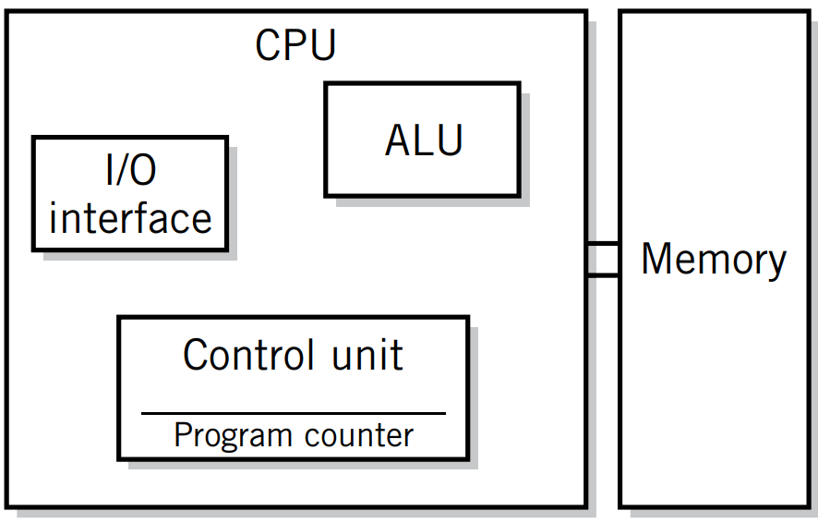
3. Memory Management Unit (MMU)
The Memory Management Unit is responsible for managing the interaction between the CPU and the computer's memory (RAM). It ensures that instructions and data are fetched from the correct memory locations. The MMU handles virtual memory, translating virtual addresses into physical addresses, and also ensures memory protection to prevent processes from interfering with each other's memory.
3A. Example
When a program accesses a variable stored in memory, the MMU translates the virtual address of that variable into the actual physical location in RAM. This makes memory access efficient and secure.
4. I/O Interface (Input/Output Interface)
The I/O Interface manages communication between the CPU and peripheral devices like keyboards, mice, printers, and storage devices. Sometimes, it is integrated into the Memory Management Unit as the Bus Interface Unit. The I/O interface allows data to be transferred between the CPU and the external world, ensuring that the system can receive inputs and provide outputs.
4A. Example
When you type on a keyboard, the I/O Interface transfers the data from the keyboard to the CPU. Similarly, when you print a document, the I/O Interface sends data from the CPU to the printer.

Slide 31
5. Other Important CPU Components
5A. Registers
Registers are small, high-speed storage locations within the CPU used to hold temporary data, instructions, or addresses during execution. These registers allow the CPU to quickly access and manipulate data without constantly reaching out to slower main memory.
Example: The CPU may use a register to hold the result of an addition operation temporarily before storing it back in memory.
5B. Bus Interface Unit (BIU)
The Bus Interface Unit is responsible for managing the communication between the CPU and other components via the system bus. This includes transferring data between the CPU, memory, and I/O devices. It coordinates how data moves between the CPU and memory, ensuring proper timing and data flow.
6. Further Example of CPU Operation
Let's say a program instructs the CPU to perform a simple calculation: A = B + C, where B = 5 and C = 3.
Fetch: The Control Unit fetches the instruction to add two numbers from memory.
Decode: The CU decodes the instruction, understanding that two numbers (B and C) need to be added.
Execute: The CU sends the numbers B (5) and C (3) to the ALU.
ALU: The ALU performs the addition (5 + 3 = 8).
Store: The result (8) is stored in memory or a register.
I/O: If the result needs to be displayed on the screen, the I/O Interface sends it to the monitor.
This sequence of operations repeats for each instruction in a program, enabling the CPU to process data and execute tasks.

Slide 32
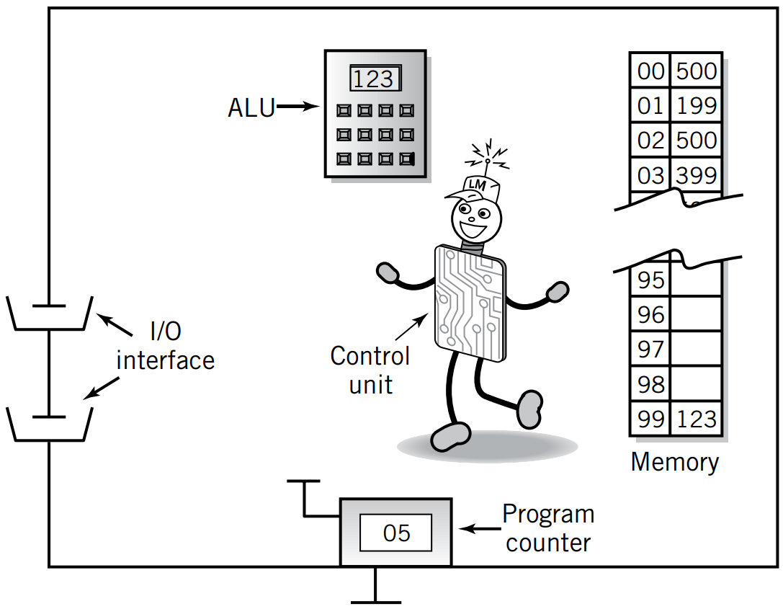
Conclusion
ALU: Handles arithmetic and logical operations.
CU: Controls the flow of instructions through the CPU.
MMU: Manages access to memory, translating addresses.
I/O Interface: Handles communication between the CPU and external devices.
Each of these components works together to allow the CPU to process instructions, manage memory, and interface with the outside world efficiently.

Slide 33
Registers
Example:
Consider the Accumulator Register in a simple CPU architecture. When performing an addition operation, the CPU might load a number from memory into the accumulator, add another number to it, and then store the result back into memory. The accumulator is permanently available for such arithmetic operations throughout the CPU’s operation.
1B. Manipulated Directly By The Control Unit
Explanation:
The Control Unit (CU) is a component of the CPU that directs its operations by managing the flow of data between registers, the Arithmetic Logic Unit (ALU), and other parts of the computer. Registers are directly manipulated by the Control Unit through signals that dictate reading from or writing to a register.
Example:
During instruction execution, the Control Unit might send a signal to the Program Counter (PC) register to increment its value after fetching an instruction. This direct manipulation ensures that the CPU moves to the next instruction in the sequence.
1. Concept of Registers
Registers are fundamental components within a computer's Central Processing Unit (CPU) that play a critical role in executing instructions and managing data. Below is a detailed explanation of the concept of registers, elaborating on each of the provided points with examples for clarity.
1A. Small, Permanent Storage Locations Within The Cpu Used For A Particular Purpose
Explanation:
Registers are small-sized storage units located inside the CPU. Unlike the main memory (RAM), which can store large amounts of data but is slower to access, registers are designed to provide rapid access to data that the CPU needs immediately. They are "permanent" in the sense that they exist as long as the CPU is powered on, but their contents can change frequently as the CPU processes different instructions.

Slide 34
1C. Wired For Specific Function
Explanation:
Each register within the CPU is designed for a specific function, meaning its wiring and connections are tailored to perform particular tasks efficiently. This specialization allows the CPU to execute operations faster and more reliably.
Example:
Instruction Register (IR): Holds the current instruction being executed. It is wired to receive instruction codes fetched from memory.
Stack Pointer (SP): Points to the top of the stack in memory, facilitating stack operations like push and pop. It is wired to interact with the stack segment of memory specifically.
1D. Size In Bits Or Bytes (Not In Mb Like Memory)
Explanation:
Registers are measured in bits or bytes, which are much smaller units of data compared to the megabytes (MB) or gigabytes (GB) used to describe main memory. This limited size is intentional, as registers are designed to hold only the most immediate and essential data needed for processing.
Example:
A 32-bit Register can hold a 32-bit binary number, which might represent a single integer value in a computation.
An 8-byte Register can store 8 bytes of data, which could include a memory address or a portion of a larger data structure.

Slide 35
1E. Can Hold Data, An Address, Or An Instruction
Explanation: Registers are versatile in the type of information they can store. Depending on their specific role within the CPU, they can hold raw data for processing, memory addresses for accessing data locations, or entire instructions to be executed.
Examples:
Data Register (DR): Holds data that is being processed by the CPU. For instance, during an addition operation, two data registers might hold the operands.
Address Register: Contains memory addresses pointing to where data or instructions are stored in main memory. The Memory Address Register (MAR) is a common example, holding the address of the next memory location to read or write.
Instruction Register (IR): Stores the current instruction being decoded and executed by the CPU. For example, if the CPU is executing an ADD instruction, the IR holds the binary code representing that ADD operation.
2. Use of Registers
Registers serve as a "scratchpad" for the currently executing program, meaning they hold data that the CPU needs immediately or frequently. Instead of accessing slower memory (RAM) every time the CPU needs data, it uses registers to speed up operations.
2A. Functions of Registers
Hold Data: For example, during a calculation, the numbers being worked on are stored in registers.
Address of Next Instruction: A special register (Program Counter) keeps track of the next instruction to be executed.
Store CPU Status: Some registers hold flags or indicators that show the status of the CPU and its operations (e.g., whether an arithmetic overflow occurred).
External Device Signals: Registers can temporarily hold signals coming from external devices like keyboards or network cards before the CPU processes them.
2B. Example
When a CPU is executing a program and needs to store the result of an addition, the numbers involved and the final result are likely stored in general-purpose registers for quick access.

Slide 36
3. Types Of Registers
3A. General-Purpose Registers
These are user-visible registers that can hold intermediate data values or results of operations. They are often used for storing values during calculations, like loop counters in a program.
Equivalent to LMC’s Calculator: In the Little Man Computer (LMC) model, the calculator is used to perform arithmetic operations. General-purpose registers serve a similar role in actual CPUs.
Typically Several Dozen: Modern CPUs have dozens of general-purpose registers to store various pieces of data temporarily.
Example: If a program needs to calculate the sum of a series of numbers, the general-purpose register might hold the running total during the calculation process.
3B. Special-Purpose Registers
These registers are designed for very specific functions, often related to controlling the execution of programs or interacting with memory and I/O devices.
Key Special-Purpose Registers:
Program Counter (PC): Also called the Instruction Pointer, it keeps track of the address of the next instruction to be executed.
Instruction Register (IR): Holds the current instruction fetched from memory, waiting to be decoded and executed.
Memory Address Register (MAR): Contains the address in memory that is being accessed, whether for reading or writing data.
Memory Data Register (MDR): Holds the actual data that is being transferred between the CPU and memory. It is a two-way register, meaning data can be read from or written to it.

Slide 37
Status Registers: Store the status of the CPU and the currently executing program. They also contain flags, which are single-bit Boolean variables used to track conditions like:
Arithmetic Carry: Signals when an arithmetic operation produces a result too large to fit in the available space.
Overflow: Indicates when an arithmetic result exceeds the representable range.
Power Failure: Alerts the system to power issues.
Internal Computer Errors: Tracks various fault conditions inside the CPU.

Slide 38
4. Register Operations
Registers perform various essential operations that facilitate program execution. Some common operations include:
Store Values: Registers hold values transferred from other locations, such as memory or other registers. For example, the result of an addition may be stored in a general-purpose register.
Example: If the CPU needs to calculate the sum of two numbers, the result might be stored in a register so that it can be used in a subsequent instruction.
Arithmetic Operations: Registers are involved in performing addition, subtraction, and other arithmetic operations.
Example: When adding two numbers, both numbers may be stored in registers, and the ALU will use these registers to perform the addition.
Shift/Rotate Data: Registers can be used to shift data left or right (bitwise shifts), which is useful in tasks like multiplication or division by powers of two.
Example: Shifting a binary number 1100 one place to the left gives 11000, effectively multiplying the number by two.
Test Conditions: Registers can hold data that is tested for certain conditions, such as whether the data is zero or positive, which helps the CPU make decisions during program execution.
Example: A status flag register might be checked to see if a zero flag is set, indicating that the result of a previous operation was zero.

Slide 39
5. Operation of Memory
Memory operates as a storage area for data and instructions. Each memory location has a unique address that allows the CPU to locate and retrieve or store data in specific locations.
5A. Steps of Memory Operation
Address from Instruction: The address of the data or instruction to be accessed is copied from the instruction into the Memory Address Register (MAR).
Example: If a program instruction says to read data from memory address 1050, this address is placed into the MAR.
CPU Determines Action: The CPU determines whether it needs to read (fetch data from memory) or write (store data into memory).
Example: The instruction may tell the CPU to retrieve data from memory to perform a calculation.
Data Transfer: Data is transferred between memory and the Memory Data Register (MDR). The MDR is a two-way register, meaning it can both receive data from memory and send data back to memory.
Example: When reading from memory, data at address 1050 is copied into the MDR so that the CPU can use it.
Conclusion
Registers are critical to the CPU's ability to perform tasks quickly, acting as temporary storage for data, instructions, and addresses.
General-Purpose Registers are flexible and can store various data values, while Special-Purpose Registers control the CPU's operations and interaction with memory and I/O devices.
Register Operations include storing values, performing arithmetic, and testing data conditions.
Memory Operations involve transferring data between memory locations and registers using the MAR and MDR.
This interplay between registers and memory allows the CPU to process instructions efficiently and manage complex tasks.

Slide 40
Relationship Between MAR, MDR And Memory
1. Relationship Between MAR, MDR, & Memory
In the context of a computer's memory system, the Memory Address Register (MAR) and the Memory Data Register (MDR) work closely together to manage how the CPU interacts with the system's memory (RAM). They play a crucial role in the fetch-execute cycle, where data or instructions are either retrieved from or stored in memory.
1A. Memory Address Register (MAR)
The MAR holds the address in memory where data is to be read from or written to.
It is a one-way register that sends the address to the memory unit.
The address held by the MAR is used to specify which memory location is being accessed.
1B. Memory Data Register (MDR)
The MDR holds the data being transferred to or from memory.
It is a two-way register because it can both receive data from memory (during a read operation) and send data to memory (during a write operation).
In a read operation, data fetched from the memory address specified by the MAR is temporarily stored in the MDR before being used by the CPU.
In a write operation, data from the CPU is placed in the MDR and then written to the memory location specified by the MAR.
1C. Memory
Memory (RAM) is where data and instructions are stored. Each location in memory has a unique address, which the MAR uses to access data.
Data flows between memory and the CPU through the MAR-MDR mechanism.

Slide 41
2. MAR-MDR Interaction: How They Work Together
The MAR and MDR work together to facilitate the CPU's access to memory. This process typically happens in two stages: fetch and write.
2A. Read Operation (Fetching Data from Memory)
Step 1: The CPU needs to fetch data (or an instruction) from memory.
Step 2: The Control Unit places the address of the required memory location into the MAR.
Step 3: The memory address is sent to the memory unit, and the memory locates the data stored at that address.
Step 4: The data at the specified memory address is copied into the MDR.
Step 5: The MDR then sends the data to the CPU for processing.
Example of a Read Operation:
Suppose a program needs to read data stored at memory address 1024.
The Control Unit places the address 1024 in the MAR.
The MAR sends this address to memory.
The memory retrieves the data stored at address 1024, say the value 45, and places it in the MDR.
The MDR sends the value 45 to the CPU, where it will be used in further computations.
2B. Write Operation (Storing Data to Memory)
Step 1: The CPU needs to write data to memory.
Step 2: The Control Unit places the address where data is to be written into the MAR.
Step 3: The CPU places the data to be written into the MDR.
Step 4: The address in the MAR and the data in the MDR are both sent to memory.
Step 5: The memory stores the data from the MDR at the memory location specified by the MAR.
Example of a Write Operation:
Suppose the CPU wants to store the value 99 in memory location 2000.
The Control Unit places the memory address 2000 in the MAR.
The CPU places the data 99 in the MDR.
The MAR and MDR send the address and data to memory.
Memory stores 99 at address 2000.

Slide 42
3. MAR-MDR Example
Let’s look at a more detailed example of how MAR and MDR work together to transfer data:
Scenario:
The CPU is running a program that needs to load a value from memory, perform a calculation, and then store the result back into memory.
3A. Step-by-Step Walkthrough
Fetching an Instruction:
The Control Unit fetches an instruction from memory, for example, “Add the number stored at memory address 1050.”
The CPU places the memory address 1050 into the MAR.
Memory retrieves the data stored at that address (e.g., 15) and copies it into the MDR.
The MDR sends the value 15 to the CPU for the addition.
Storing a Result:
After performing the addition (say 15 + 20 = 35), the CPU needs to store the result 35 in memory location 2000.
The CPU places the memory address 2000 in the MAR.
The result (35) is placed in the MDR.
The data from the MDR is written to memory location 2000, completing the operation.

Slide 43
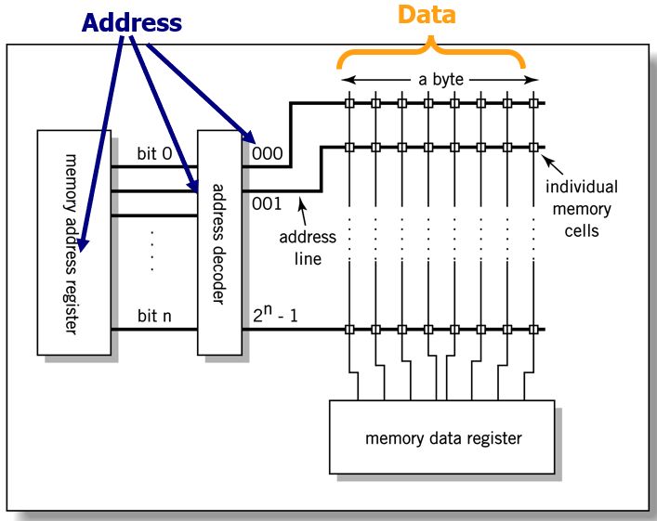
Conclusion
The MAR and MDR are critical components of the CPU that enable communication with the memory system.
MAR holds the memory address to be accessed.
MDR holds the actual data being transferred to or from that memory location.
These registers streamline the process of reading data from memory and writing data to memory, ensuring the CPU can access the necessary data for processing efficiently.
By using the MAR to locate specific memory addresses and the MDR to temporarily hold the data during transfers, the CPU can efficiently manage memory read and write operations.
The interaction between the MAR, MDR, and memory allows the CPU to execute programs smoothly, whether it’s fetching an instruction, reading data for calculations, or writing results back to memory.
This system of registers ensures that the CPU operates quickly without the need to directly interact with slower memory components for every operation.
In summary, the MAR and MDR serve as essential tools in the memory communication process, helping the CPU to access memory efficiently and maintain a high level of performance in executing instructions.

Slide 44
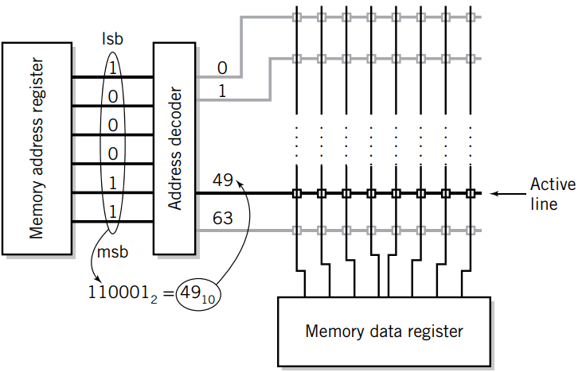
MAR-MDR Example
1. Memory Address Register (MAR)
MAR holds the address of the memory location that the CPU wants to access (either to read from or write to). In the diagram, you can see that the address "110001" in binary is stored in the MAR.
The binary number 110001₂ corresponds to 49₁₀ in decimal, meaning it is referring to the 49th memory location.
Example: If a processor wants to fetch data stored at memory location 49, the MAR will hold that address (110001 in binary).
2. Address Decoder
The address decoder is responsible for translating the binary address from the MAR into a signal that selects the specific memory location. In the diagram, this decoder translates the binary address 110001 (or 49 in decimal) and activates the appropriate line (the 49th line) in memory to access the desired data.
Example: The decoder will interpret the MAR value 110001₂ and activate the corresponding address line in the memory array.
The diagram you've provided appears to represent a typical example of how data is accessed in memory using the Memory Address Register (MAR) and Memory Data Register (MDR). Let’s break down the key terms and components in the diagram, as well as their functions and how they work together.

Slide 45
3. Memory Data Register (MDR)
The MDR temporarily holds the data that is being transferred to or from the addressed memory location. If the CPU is reading data, the MDR will receive data from the memory location addressed by the MAR. If the CPU is writing data, the MDR will hold the data that needs to be stored in the memory at the address provided by the MAR.
Example: Suppose the CPU wants to read the value stored at location 49. The address 49 is placed in the MAR, the decoder activates the 49th line, and the data at that memory location is loaded into the MDR.
4. Address Lines and Memory Access
The address lines shown on the right side of the diagram represent the pathways used to select the correct memory location based on the address in the MAR. For example, when the binary address "110001" is decoded, it activates line 49.
Active Line: Only one line (in this case, the 49th) will be active at a time, allowing the memory operation (read or write) to occur at that specific location.
Example: Imagine a memory block with 64 locations (from 0 to 63). The address "110001₂" activates the 49th memory location.

Slide 46
5. MSB and LSB (Most Significant Bit and Least Significant Bit)
MSB refers to the leftmost bit in a binary number, which has the highest value (in this case, the most significant bit in the address 110001 is "1").
LSB refers to the rightmost bit, which has the lowest value (in this case, the least significant bit is "1").
Example: In the address 110001₂, the MSB is 1 (value 32 in decimal) and the LSB is 1 (value 1 in decimal).
7. Binary-to-Decimal Conversion
The binary number 110001₂ is equal to 49₁₀ in decimal. This is calculated as: 1×2^5 + 1×2^4 + 0×2^3 + 0×2^2 + 0×2^1 + 1×2^0 = 49
Example: If the binary address was 101010, it would correspond to 42 in decimal, which would activate the 42nd memory line.
7A. Memory Access Example
Let's say the CPU wants to read data from memory location 49. Here’s how the process works:
Step 1 (Addressing): The CPU places the binary address 110001₂ (49 in decimal) into the MAR.
Step 2 (Decoding): The address decoder translates this binary address into an active line (49th line) in the memory array.
Step 3 (Data Transfer): The data at memory location 49 is transferred to the MDR for the CPU to process.
6. Memory Array
The memory array is made up of multiple cells or locations where data is stored. Each location has a unique address. In this case, the diagram shows multiple lines, representing individual memory locations that can be accessed based on the address sent from the MAR.
Example: A memory array might consist of 64 locations (addressed from 0 to 63). By placing a binary number in the MAR, the address decoder selects one of these locations for reading or writing.

Slide 47
7B. Additional Example (Writing To Memory)
If the CPU wanted to store data in memory location 49:
The CPU would load the binary address 110001₂ (49 in decimal) into the MAR.
The address decoder would activate the 49th memory line.
The CPU would place the data it wants to store into the MDR, and that data would be written into the memory at location 49.
7C. Summary Of Key Points
MAR holds the memory address to be accessed.
MDR temporarily stores the data being read or written.
Address Decoder translates the address in MAR to select the correct memory location.
The binary address is converted into a decimal value to activate the appropriate memory line.

Slide 48
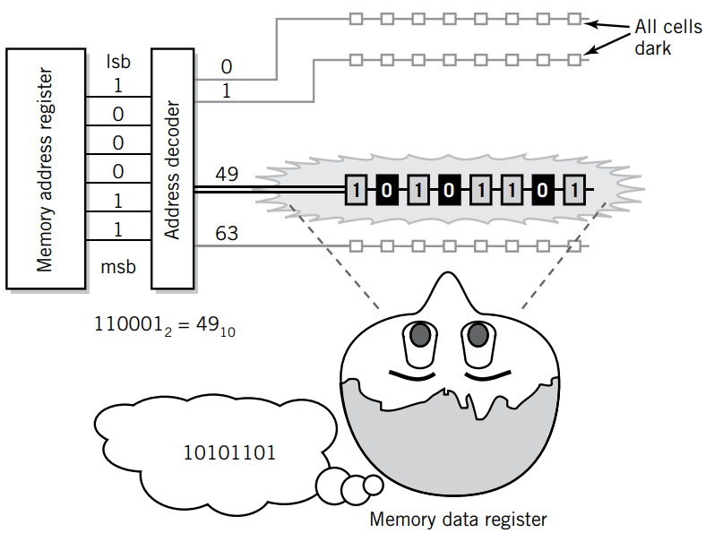
Visual Analogy Of Memory
The image offers a visual analogy of memory operations using both the Memory Address Register (MAR) and the Memory Data Register (MDR). Here's a breakdown of each component in the image and its function in memory operations:
1. Key Components in the Image
Memory Address Register (MAR):
The MAR is shown on the left as a register containing binary digits (bits). In this example, the value stored in the MAR is 110001 (binary), which corresponds to the decimal value 49.
The MAR holds the address in memory where data needs to be fetched from or written to. In this case, it points to memory location 49.
Address Decoder:
The address decoder is a circuit that takes the binary value from the MAR (110001) and activates a specific memory cell associated with that address.
In this case, address 49 is selected. The address decoder ensures that only the correct memory location is accessed (in this case, memory location 49).

Slide 49
Memory Cells:
The memory cells are visualized as a horizontal array of binary values (bits), where each location corresponds to a specific address. For example, memory location 49 contains the value 10101101 (binary).
Memory cells are the actual locations in memory where data is stored. Each cell has a unique address (in this case, 49 is shown).
Memory Data Register (MDR):
The MDR is represented by a figure at the bottom right, visualizing it as a "container" or "thought bubble" holding data (10101101).
The MDR holds the data being transferred between memory and the CPU. In this case, the data from memory location 49 (which is 10101101) is placed in the MDR.
2. Step-By-Step Explanation Of Memory Operation (Based On The Image):
2A. Storing the Address in MAR
The MAR holds the address of the memory location to be accessed. In this example, the MAR contains the binary value 110001, which is 49 in decimal.
This address (49) is sent to the address decoder.
2B. Address Decoder Operation
The address decoder interprets the binary value in the MAR and selects the corresponding memory location. In this case, it points to memory location 49.
The decoder ensures that the correct memory cell is activated, and only the data at that location is retrieved.
2C. Fetching Data from Memory
The memory location 49 contains the binary data 10101101.
This data is fetched and transferred to the Memory Data Register (MDR).
2D. MDR Holds the Data
The MDR now holds the data (10101101) that was fetched from memory location 49. This data can then be used by the CPU for processing or stored back in memory later.

Slide 50
3. Visual Analogy of Memory
MAR as the "Finder": The MAR acts as a guide to find the specific memory location by holding the address (49 in this case).
Address Decoder as the "Translator": The address decoder translates the binary address from the MAR into an actual memory location and activates the correct memory cell.
Memory Cells as "Storage Units": Each memory location (like 49) acts as a storage unit holding data (in this case, 10101101).
MDR as the "Courier": The MDR acts like a courier, fetching the data from memory and delivering it to the CPU or storing it back in memory.
4. Real-World Example
Imagine you're looking for a specific book in a library.
The MAR is like the catalog number you use to find the book's location on the shelf.
The address decoder is the librarian helping you locate the exact shelf where the book is stored.
The memory cells are like the shelves containing books (data).
The MDR is like you, the reader, holding the book after finding it, ready to read (or in the CPU’s case, ready to process the data).

Slide 51
Conclusion
The visual analogy in this image simplifies how memory operates by breaking down the roles of MAR and MDR. The MAR finds the address, the address decoder activates the correct memory location, and the MDR fetches or writes data to/from that location.
This process allows the CPU to efficiently execute programs by retrieving and storing data as needed.
The relationship between MAR, MDR, and memory is crucial for ensuring that data is fetched and stored in the correct locations during CPU operations. The MAR specifies where to look, the MDR holds what is being looked for (or stored), and the address decoder ensures efficient access to memory locations.
This analogy helps simplify the underlying complexity of how modern CPUs interact with memory and illustrates how core components (MAR, MDR, and memory) enable the execution of instructions in a systematic and orderly manner.
By visualizing this process, it becomes clearer how important memory management is for the CPU's speed and performance, ensuring that the right data is available at the right time to keep processing efficient and error-free.
Understanding these operations is fundamental to grasping how computers perform complex tasks by coordinating between their memory and processing units.

Slide 52
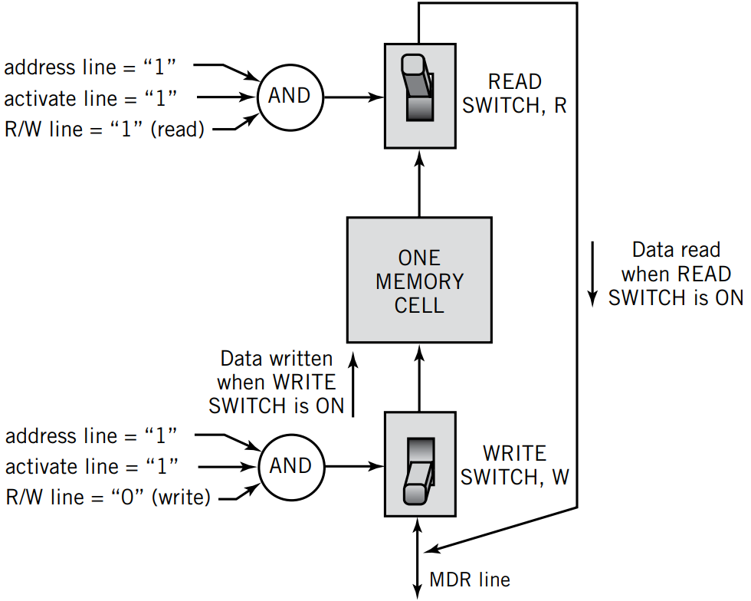
Individual Memory Cell
The provided diagram illustrates the workings of an individual memory cell in a computer's memory system, showing how data is read from and written to the memory cell through the use of switches and control signals. Each individual memory cell is a fundamental unit in a memory structure, and the diagram breaks down how the read and write operations are controlled. Let's explain each component and its role in detail.
1. Components Of The Individual Memory Cell
One Memory Cell:
This is the core unit where data is stored. A memory cell can hold either a 1 or 0 (binary values), representing the smallest piece of data.
Data is stored here until it is read or written during the operations.
Read Switch (R):
The Read Switch (R) controls whether data is being read from the memory cell. When this switch is on, data is retrieved from the memory cell and sent to the output line.
The read operation happens when specific conditions are met (explained below), allowing the CPU or another component to retrieve the stored data.

Slide 53
Write Switch (W):
The Write Switch (W) controls whether data is being written into the memory cell. When this switch is on, data from the Memory Data Register (MDR) is written to the memory cell.
The write operation stores new data into the memory cell and is triggered by certain conditions (explained below).
AND Logic Gates:
There are two AND gates in the diagram, each responsible for determining when either the Read Switch (R) or the Write Switch (W) should be activated.
AND gates combine multiple control signals, ensuring that the switches are only activated when all required signals are in place.
2. How The Read Operation Works
2A. Control Signals for Reading:
The read operation requires three conditions to be met:
Address line = 1: This signal indicates that the specific memory cell is being accessed.
Activate line = 1: This indicates that the cell is ready for access.
R/W line = 1 (read): This specifies that the operation is a read operation (as opposed to a write).
2B. AND Gate Activation:
The AND gate checks whether all three signals (address, activate, and R/W read) are equal to 1. If they are all 1, the output of the AND gate is 1, which turns on the Read Switch (R).
2C. Reading Data:
When the Read Switch (R) is on, the data stored in the memory cell (either a 1 or 0) is passed to the output line. This data is then sent to the CPU or other components for use.
The diagram shows how the data flows from the memory cell to the Read Switch, then out of the memory system.

Slide 54
3. How The Write Operation Works
3A. Control Signals for Writing
The write operation also requires three conditions:
Address line = 1: Indicates that the specific memory cell is being accessed.
Activate line = 1: The cell is ready to be written into.
R/W line = 0 (write): This specifies that the operation is a write operation.
3B. AND Gate Activation
The AND gate for the write operation checks whether the address, activate, and R/W write signals are all 1 and 0 respectively. If they are, the output of the AND gate is 1, turning on the Write Switch (W).
3C. Writing Data
When the Write Switch (W) is turned on, the data from the MDR line (coming from the Memory Data Register) is written into the memory cell.
This overwrites the previous value in the memory cell with the new value provided by the MDR, which is typically sent from the CPU or other component.
4. Example Of Read And Write Operations
Read Operation:
Suppose the CPU wants to read data stored in memory cell 49 (as in the previous diagram).
The address line is set to 1 for cell 49.
The activate line is set to 1, indicating that cell 49 is ready.
The R/W line is set to 1 for a read operation.
The AND gate checks if all the conditions are met, and when they are, the Read Switch (R) turns on, allowing data from the memory cell to flow to the output.
The CPU receives the stored data.
Write Operation:
Suppose the CPU wants to write the value 10101101 into the memory cell.
The address line is set to 1 for the memory cell.
The activate line is set to 1.
The R/W line is set to 0, indicating a write operation.
The AND gate for writing activates the Write Switch (W), allowing the value from the MDR line to be written into the memory cell.
The previous data in the memory cell is replaced by the new value, completing the write operation.

Slide 55
Conclusion
An individual memory cell can store a single bit of data (0 or 1), and the operations of reading from or writing to the memory cell are controlled by a combination of switches and logic gates.
The Read Switch enables the CPU to fetch data from the memory cell, while the Write Switch allows the CPU to store new data into the memory.
By using control signals like the address line, activate line, and R/W line, the CPU can select specific memory cells to read from or write to, ensuring that data is accurately stored and retrieved as needed.
This structure ensures that memory operations are efficient, and that the data integrity is maintained through well-coordinated read and write mechanisms.
In essence, an individual memory cell serves as the smallest unit of memory, but combined with others, it allows a system to store complex instructions and data in a highly organized manner.

Slide 56
Memory Capacity
Example 2:
If the MAR is 32 bits wide, it can address 2^32 = 4,294,967,296 locations.
This equals 4 gigabytes (GB) of memory, which is common in many modern computers.
1B. LMC (Little Man Computer) Example
In the LMC, the number of bits in the MAR is limited to a range of 00 to 99, which gives 100 memory locations in total.
So, the MAR can reference 100 unique memory addresses.
1C. Real-World Example
In modern systems, a 64-bit wide MAR would mean it could address 2^64 = 18,446,744,073,709,551,616 unique memory locations (approximately 18 exabytes). While no individual system currently uses this much memory, it's a theoretical limit for 64-bit processors.
Memory capacity in a computer is a measure of how much data or information can be stored in memory (such as RAM). The total memory capacity is influenced by two main factors:
1. Number Of Bits In The Memory Address Register (Mar)
The Memory Address Register (MAR) stores the memory location where data is being accessed (read or written). The number of bits in the MAR determines how many unique addresses the system can reference, which directly affects the memory capacity.
1A. Formula
For an address register with K bits, the total number of addressable memory locations is 2^K (2 raised to the power of K).
Example 1:
If the MAR is 8 bits wide, it can store 2^8 = 256 different addresses.
This means the computer can access 256 unique memory locations.

Slide 57
2. Size Of The Address Portion Of The Instruction
Each instruction executed by the CPU contains an address portion, which specifies the location in memory where the data or instructions are stored. The size of this address portion is another limiting factor on memory capacity.
The more bits that are used for the address portion, the larger the memory capacity, as more unique addresses can be specified.
2A. Examples
4-bit Address Portion:
A 4-bit address allows for 2^4 = 16 memory locations.
In this case, the CPU can only address 16 different memory cells, which is suitable for simple devices with minimal memory requirements.
8-bit Address Portion:
An 8-bit address portion allows for 2^8 = 256 memory locations.
This would allow the CPU to access 256 different memory locations, similar to early computers or embedded systems.
32-bit Address Portion:
A 32-bit address portion allows for 2^32 = 4,294,967,296 memory locations.
This means the system could have access to 4 GB of memory, which was the standard for a long time in 32-bit systems.
64-bit Address Portion:
A 64-bit address portion allows for 2^64 addresses.
This allows addressing of up to 18 exabytes (as explained earlier), which is more than enough for current memory demands.
2B. Example Of Instruction Set
In an instruction with an 8-bit address portion, the CPU can reference up to 256 memory locations. These locations could hold either data or additional instructions that the CPU needs to execute.

Slide 58
3. Detailed Examples of Memory Capacity
4-bit Address Example:
A system with a 4-bit address portion would have 2^4 = 16 possible memory locations.
If each location holds 1 byte of data, the total memory capacity would be 16 bytes.
This could be sufficient for very basic systems like microcontrollers used in embedded applications.
32-bit Address Example:
A system with a 32-bit MAR and address portion can have up to 2^32 = 4,294,967,296 addresses.
If each addressable location holds 1 byte of data, the total memory capacity is 4 GB.
This was the limit for most 32-bit systems like Windows computers until the shift to 64-bit architecture.
64-bit Address Example:
A 64-bit system can address up to 2^64 locations.
If each location holds 1 byte, this would allow for 18 exabytes of memory.
While no current computers use this much memory, 64-bit processors are future-proofed for substantial increases in memory usage as technology advances.
Conclusion
The memory capacity of a system is primarily determined by two factors:
The number of bits in the MAR: This determines how many unique memory locations the system can address.
The size of the address portion of the instruction: This limits how much memory can be accessed in a single instruction.
In both cases, larger bit widths enable systems to access more memory, which is essential as modern applications demand more resources. For example, early computers had memory limitations measured in kilobytes (KB) or megabytes (MB), while today’s computers handle gigabytes (GB) or even terabytes (TB) of memory.
Understanding these concepts is critical for designing efficient computer architectures and optimizing memory management.

Slide 59
RAM (Random Access Memory)
Random Access Memory (RAM) is the primary memory used by a computer to store data temporarily while programs are running. RAM is volatile memory, meaning its data is lost when the computer is powered off. It is critical for system performance because it provides fast read and write access to data needed for current tasks.
There are two main types of RAM: Dynamic RAM (DRAM) and Static RAM (SRAM). Both types are volatile but serve different roles based on their performance and cost.
1. DRAM (Dynamic RAM)
1A. Characteristics
Dynamic RAM (DRAM) is the most common type of RAM used in computers.
It is cheaper, consumes less electrical power, produces less heat, and requires less physical space than SRAM.
Volatile: The data stored in DRAM needs to be refreshed or recharged thousands of times each second to prevent data loss, as the capacitors holding the data leak charge over time.
1B. How DRAM Works
DRAM stores each bit of data in a tiny capacitor. A capacitor can either be charged (representing a 1) or discharged (representing a 0).
Over time, the charge in the capacitors leaks away, which is why DRAM needs to be refreshed frequently (typically thousands of times per second).
The constant refreshing is what makes DRAM dynamic.
1C. Example
Consider an 8 GB DRAM module in a laptop. When the laptop is powered on, the DRAM is constantly recharged to maintain the data. This allows the operating system and applications to run smoothly by keeping frequently accessed data in memory.
Without frequent refreshing, the data in the capacitors would quickly degrade, and the stored information would be lost.

Slide 60
1D. Real-World Example
DRAM is commonly used in main memory (also known as RAM) for most computers, smartphones, and tablets.
For instance, a modern laptop with 8 GB of DDR4 DRAM can handle multiple applications running simultaneously, such as a web browser, video player, and office software.
1E. Pros of DRAM
Cost-effective: DRAM is much cheaper to manufacture compared to SRAM.
High capacity: DRAM can store large amounts of data and is scalable to meet the needs of modern applications.
1F. Cons of DRAM
Slower than SRAM: DRAM has slower access times compared to SRAM.
Requires constant refreshing: The need for continuous refreshing makes DRAM less energy-efficient.
2. SRAM (Static RAM)
2A. Characteristics
Static RAM (SRAM) is faster and more reliable than DRAM, but it is also significantly more expensive.
Unlike DRAM, SRAM does not need to be refreshed constantly, as it retains data as long as power is supplied.
SRAM is still volatile, meaning data is lost when power is turned off.
Due to its higher cost, small amounts of SRAM are typically used in cache memory, which is a type of high-speed memory located close to the CPU for quick access.
2B. How SRAM Works
SRAM uses flip-flop circuits to store each bit of data, rather than capacitors. This makes SRAM more stable and faster because the flip-flop circuits maintain their state as long as power is provided.
As a result, SRAM does not need to be refreshed like DRAM, which is why it is called static.

Slide 61
2C. Example
A modern processor, like an Intel i7 CPU, may include SRAM as L1, L2, or L3 cache memory. This cache is used to store frequently accessed data and instructions so the CPU can retrieve them quickly, improving overall system performance.
In this case, a small amount of SRAM (say, 256 KB to 8 MB in modern CPUs) is enough to provide significant performance boosts for CPU operations.
2D. Real-World Example
SRAM is typically used for cache memory in CPUs and other components where speed is critical.
For example, in a gaming console, the SRAM cache ensures that the most frequently used instructions are accessed quickly, reducing lag and improving frame rates during gameplay.
2E. Pros of SRAM
Faster: SRAM is significantly faster than DRAM because it doesn't require constant refreshing.
More reliable: Since it doesn’t need to be refreshed, SRAM offers more stability and faster access times.
2F. Cons of SRAM
More expensive: The complex structure of flip-flop circuits makes SRAM more costly to manufacture compared to DRAM.
Larger physical size: Due to its more complex circuitry, SRAM takes up more space, which limits its scalability in comparison to DRAM.

Slide 62
3. Comparison Between DRAM And SRAM
Feature | DRAM | SRAM
Cost | Cheaper | More expensive
Speed | Slower than SRAM | Faster
Power consumption | Lower power consumption | Higher power consumption
Physical size | Smaller | Larger
Use case | Main memory (RAM) | Cache memory in CPUs
Volatility | Volatile (needs frequent refresh) | Volatile (no need for refresh)
Structure | Uses capacitors to store data | Uses flip-flops to store data
Data Refresh | Needs to be refreshed constantly | No need for refreshing

Slide 63
4. Real-World Examples of Usage
Laptop With DRAM:
A typical laptop might have 8 GB or 16 GB of DRAM. This memory is used to store open applications and operating system processes, providing fast access to the CPU. When the system is running, the DRAM is continuously refreshed to maintain the stored data. If the laptop is powered off, all data in DRAM is lost.
SRAM Cache In A CPU:
SRAM is used as cache memory in CPUs. Modern processors have multiple levels of cache (L1, L2, L3), which store frequently accessed data close to the CPU cores. Since SRAM is much faster than DRAM, it helps speed up the processing by reducing the time needed to fetch data.
Conclusion
DRAM is the most commonly used memory in computers due to its affordability and large storage capacity. It is well-suited for main memory but requires frequent refreshing due to its dynamic nature.
SRAM, on the other hand, is much faster and more stable but comes at a higher cost. Therefore, it is reserved for smaller, high-performance roles, such as cache memory in CPUs, where quick access to frequently used data is essential.
Understanding the differences between DRAM and SRAM helps in optimizing system performance by choosing the appropriate type of memory for specific tasks. For example, using DRAM for general memory and SRAM for high-speed cache helps strike a balance between cost and performance.

Slide 64
Nonvolatile Memory
How ROM Works:
The data stored in ROM is written during the manufacturing process, and this data can only be read, not modified. It provides essential instructions for the computer or device, such as initializing hardware during the boot process.
Example:
When you turn on your desktop or laptop, the BIOS stored in ROM is executed first to initiate hardware diagnostics and load the operating system.
Real-World Example:
ROM is used in gaming consoles to store firmware that manages the console's boot process, user interface, and system security. Since this firmware rarely changes, it's stored in ROM for stability and reliability.
Pros of ROM:
Permanent storage: Data in ROM is not lost when the power is turned off.
Security: Since the data cannot be modified, ROM is tamper-resistant, making it ideal for storing system-critical code.
Nonvolatile memory is a type of memory that retains its data even when the power is turned off. This is crucial for storing essential system data or files that should persist across reboots or power failures. Common types of nonvolatile memory include ROM (Read-Only Memory), EEPROM (Electrically Erasable Programmable ROM), and Flash Memory. These types of memory are typically used to store firmware, boot code, and long-term data.
1. ROM (Read-Only Memory)
Characteristics:
Read-only Memory (ROM) is a type of nonvolatile memory that is permanently programmed during manufacturing. Once data is written to ROM, it cannot be modified or erased, making it a stable and secure storage solution.
ROM is used to store firmware or permanent software, such as the computer's BIOS (Basic Input/Output System) or embedded system programs that are not expected to change during the system's lifetime.

Slide 65
Cons of ROM:
No flexibility: Once programmed, data in ROM cannot be changed or updated.
2. EEPROM (Electrically Erasable Programmable ROM)
Characteristics:
EEPROM is a type of ROM that can be electrically erased and reprogrammed. Unlike standard ROM, EEPROM allows data to be modified after it's been initially written.
Nonvolatile: Like ROM, EEPROM retains its data when the power is off, but it is more flexible because it can be erased and rewritten electrically without removing the memory chip.
How EEPROM Works:
The data in EEPROM is written and stored using electrical signals. When it's time to erase or modify the data, an electrical charge is applied to reset the bits, allowing new data to be written. However, this rewriting process is typically slower compared to writing data to RAM or flash memory.
Example:
EEPROM is often used in BIOS chips in modern computers, where system settings, configurations, and firmware can be updated without removing or replacing the ROM chip.

Slide 66
Real-World Example:
EEPROM is frequently used in embedded systems, such as the control units in cars, where the system software can be updated during routine maintenance without replacing any physical components.
Pros of EEPROM:
Reprogrammable: EEPROM can be erased and reprogrammed multiple times, making it more versatile than ROM.
Nonvolatile: It retains its data even when the system is powered down.
Cons of EEPROM:
Slow write times: The process of erasing and reprogramming EEPROM is relatively slow compared to RAM or even flash memory.
3. Flash Memory
Characteristics:
Flash memory is a form of EEPROM that is faster and can store larger amounts of data. It is nonvolatile and is widely used for portable storage and embedded systems.
Unlike standard EEPROM, flash memory is faster in reading and writing data but still slower than traditional RAM when it comes to rewriting or modifying data.
Flash memory uses a process called hot carrier injection to store bits of data in memory cells.
How Flash Memory Works:
Flash memory stores data in memory cells, which are made up of floating-gate transistors. These transistors hold electrical charges that represent binary data (1s and 0s). Hot carrier injection is used to add or remove charges from these transistors, enabling data storage.
Flash memory can be written and erased at the block level, meaning data is rewritten in blocks rather than individual bytes, which improves performance but slows down the rewrite time compared to RAM.

Slide 67
Types of Flash Memory:
NAND Flash Memory: Commonly used in USB drives, SSDs (Solid State Drives), and memory cards. It's more efficient for larger storage but has slower read/write speeds compared to DRAM.
NOR Flash Memory: Used in applications where faster read speeds are necessary, such as in the BIOS of computers or for executable code in embedded systems.
Example:
USB flash drives use NAND flash memory to store and transfer files between computers. The data remains even when the drive is unplugged, making it a highly portable storage solution.
Real-World Example:
Flash memory is used in solid-state drives (SSDs), which have become a popular alternative to hard disk drives (HDDs) in laptops and desktops. SSDs provide faster boot times, quicker file access, and greater durability due to their lack of moving parts.
Pros of Flash Memory:
Faster than ROM and EEPROM: Flash memory offers much faster read and write speeds compared to traditional nonvolatile memory.
Nonvolatile: Data is retained when the power is turned off.
Portable: It is widely used in portable storage devices like USB drives, memory cards, and SSDs.
Cons of Flash Memory:
Slower rewrite time than RAM: Although faster than ROM and EEPROM, flash memory is still slower than RAM when it comes to rewriting data.
Limited write cycles: Flash memory has a finite number of write/erase cycles before it becomes unreliable.

Slide 68
4. Detailed Example Scenarios
ROM in Embedded Systems:
In an embedded system (such as a microwave), the firmware that controls the system is stored in ROM. The firmware is rarely updated, so the data is written once during manufacturing and remains in ROM for the lifetime of the product.
EEPROM in Automotive Control Units:
In modern cars, EEPROM is used in engine control units (ECUs) to store vehicle settings and configurations. These settings can be updated during a software upgrade or routine maintenance, but the data remains intact when the vehicle is powered off.
Flash Memory in SSDs:
An SSD in a modern laptop uses NAND flash memory. When the laptop is shut down, all the files and the operating system are stored in flash memory. The next time the system is powered on, the SSD retrieves this data much faster than a traditional HDD.
Flash Memory in Smartphones:
Flash memory is used in smartphones for storing the operating system, apps, photos, and other files. When the phone is turned off or runs out of battery, the data remains stored and accessible when the phone is powered on again.

Slide 69
5. Comparison of Nonvolatile Memory Types
Conclusion
ROM is best suited for storing permanent system instructions or firmware that doesn’t need to be modified.
EEPROM allows for updates to stored data while retaining its nonvolatile nature, making it ideal for systems where updates are necessary but infrequent.
Flash memory offers a balance of speed and storage capacity, making it the go-to option for portable and high-capacity storage, but it has slower rewrite times compared to volatile memory like RAM.
Understanding these types of nonvolatile memory helps engineers and designers choose the right kind of memory based on the needs of the system, whether it be stable firmware, updatable software, or portable data storage.
Feature | ROM | EEPROM | Flash Memory
Volatility | Nonvolatile | Nonvolatile | Nonvolatile
Modifiability | Not modifiable | Reprogrammable | Reprogrammable
Cost | Relatively low | Higher than ROM | Higher than EEPROM
Speed | Slow | Slower than flash | Faster than ROM and EEPROM
Use Case | Firmware and BIOS storage | Embedded systems, control units | Portable storage, SSDs, mobile
Capacity | Small storage (firmware) | Moderate storage | Large storage (up to terabytes)
Write Cycles | Cannot be rewritten | Limited write cycles | Limited write cycles (higher than EEPROM)

Slide 70
Fetch-Execute Cycle
2. Step-by-Step Breakdown of the Fetch-Execute Cycle:
2A. Fetch (Retrieve the instruction)
The CPU is directed to the memory location of the next instruction (usually stored in the Program Counter (PC), which keeps track of the address of the next instruction to execute).
The CPU fetches the instruction from memory and stores it in the Instruction Register (IR).
Example: Let’s say the instruction is to add two numbers stored in memory locations. The CPU will fetch this instruction, usually represented in binary form, and load it into the instruction register.
The Fetch-Execute Cycle, also known as the Instruction Cycle, is the basic operational process of a computer's central processing unit (CPU). It is the process by which a computer retrieves a program instruction from its memory, determines what actions the instruction dictates, and then carries out those actions.
1. Overview of the Fetch-Execute Cycle
The cycle has two main stages:
Fetch – retrieving the instruction from memory.
Execute – executing the operation specified by the instruction.
However, we can break this down further into smaller sub-steps for clarity.

Slide 71
2B. Decode (Identify the instruction)
The control unit of the CPU decodes the instruction stored in the Instruction Register.
The CPU decodes what the instruction is asking for, such as which operation (add, subtract, move data, etc.) needs to be executed and what operands are involved (whether they are stored in registers or in memory).
If the instruction involves data, the CPU may also fetch additional information, such as memory addresses or data to operate on, before the execution step.
Example: If the fetched instruction is ADD R1, R2, R3, the CPU decodes this to understand that it needs to add the contents of registers R2 and R3 and store the result in R1.
2C. Execute (Perform the operation)
The CPU’s Arithmetic Logic Unit (ALU) or another functional unit performs the actual operation as per the decoded instruction.
The operation could involve arithmetic (like addition or subtraction), logic (like AND, OR), or data transfer (moving data from one place to another).
Example: In the case of the instruction ADD R1, R2, R3, the ALU adds the contents of R2 and R3 and stores the result in R1.

Slide 72
2D. Store (Optional, depending on instruction)
For some instructions, the result of the execution may need to be stored back in a register or memory location.
This phase moves the processed data to the appropriate location.
Example: Once the addition is completed in the previous example, the result is stored in R1, meaning that R1 now holds the sum of R2 and R3.
3. Two-Cycle Process (Instruction and Data in Memory)
The CPU follows a two-cycle process because both instructions and data are stored in memory.
Instruction Fetch Cycle:
The CPU first fetches the instruction from memory.
Data Fetch Cycle (when required):
If the instruction needs some data (e.g., numbers for a calculation), the CPU fetches that from memory in the next cycle.
For example:
If an instruction is to load a number from memory into a register, it first fetches the instruction telling it to perform the load, and then in the next cycle, it fetches the actual number from memory.

Slide 73
4. Additional Notes
Program Counter (PC): The register that holds the memory address of the next instruction to be executed.
Instruction Register (IR): The register where the currently fetched instruction is stored.
Arithmetic Logic Unit (ALU): The part of the CPU that performs arithmetic and logic operations.
Control Unit: The component of the CPU that decodes instructions and directs other parts of the CPU to perform the necessary operations.
5. Example of the Fetch-Execute Cycle in Practice
Let’s assume a simple program is loaded into memory that asks the CPU to add two numbers:
5A. Memory Contents
Address 100: LOAD R1, #50 (Load the number 50 into register R1)
Address 101: LOAD R2, #25 (Load the number 25 into register R2)
Address 102: ADD R3, R1, R2 (Add the contents of R1 and R2 and store the result in R3)

Slide 74
6. Step-by-Step Execution
Fetch the first instruction (LOAD R1, #50) from memory address 100. The instruction is loaded into the Instruction Register (IR).
Decode the instruction to determine that the CPU needs to load the number 50 into register R1.
Execute the operation by loading the number 50 into register R1.
Next:
Fetch the second instruction (LOAD R2, #25) from memory address 101.
Decode the instruction to load the number 25 into register R2.
Execute the operation by loading 25 into register R2.
Finally:
Fetch the third instruction (ADD R3, R1, R2) from memory address 102.
Decode the instruction to add the contents of registers R1 and R2.
Execute the addition operation by adding the values (50 + 25 = 75) and storing the result in register R3.
This cycle repeats continuously, allowing the CPU to process instructions in a program step by step.

Slide 75
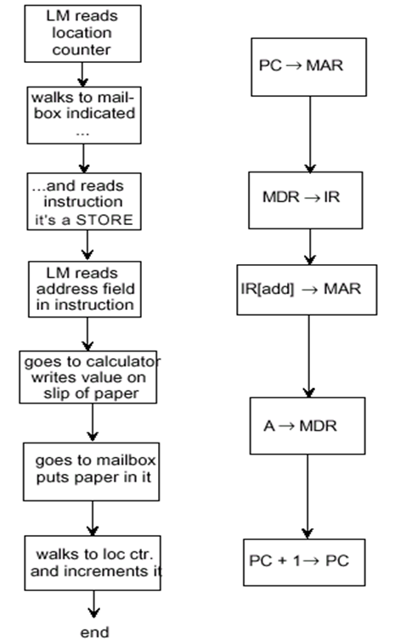
LMC vs. CPU (Fetch and Execute Cycle
The image appears to represent a visual analogy between the Little Man Computer (LMC) model and a real CPU, focusing on the Fetch-Execute Cycle. Let's explore the similarities between the two systems and explain the Fetch and Execute cycle for each.
1. Little Man Computer (LMC)
The LMC is a simplified computer model designed to help learners understand how a CPU functions at a basic level. In this analogy, the "Little Man" represents the CPU, and various operations, like fetching instructions and data, are depicted as the Little Man interacting with different elements like a mailbox (memory), location counter (Program Counter), and calculator (Arithmetic Logic Unit - ALU).
1A. LMC Fetch-Execute Cycle Steps (Left Side)
LM reads location counter:
The location counter is equivalent to the Program Counter (PC) in a real CPU. It keeps track of the next instruction to execute.
The Little Man (LM) starts by reading the location counter to see where to fetch the next instruction from.
Walks to mailbox indicated by location counter:
The Little Man uses the value from the location counter to find the corresponding mailbox (representing memory).
He walks over to the mailbox, which contains the instruction.

Slide 76
Reads the instruction:
The Little Man reads the instruction from the mailbox and understands what operation it requires (e.g., a STORE operation).
LM reads address field in instruction:
The instruction may contain additional data or an address. In the case of a STORE operation, the Little Man reads the address where the value should be stored.
Goes to calculator (ALU):
The calculator represents the Arithmetic Logic Unit (ALU) of the CPU.
The Little Man performs any necessary calculations or operations, such as writing a value on a piece of paper (performing the arithmetic).
Puts the paper into the mailbox:
After performing the operation (e.g., STORE), the Little Man puts the result or data back into the appropriate mailbox (memory).
Walks to location counter and increments it:
After finishing the current instruction, the Little Man increments the location counter so that the next instruction can be fetched.
The cycle repeats from step 1.

Slide 77
1B. CPU Fetch-Execute Cycle (Right Side)
This is the equivalent cycle in a modern CPU with more technical terminology.
PC → MAR (Program Counter → Memory Address Register):
The Program Counter (PC) holds the memory address of the next instruction to be executed.
The CPU copies the PC's value into the Memory Address Register (MAR), which holds the address of the memory location to be accessed.
MDR → IR (Memory Data Register → Instruction Register):
The CPU fetches the instruction from memory and places it in the Memory Data Register (MDR). Then, it moves the instruction into the Instruction Register (IR) for decoding.
IR[add] → MAR (Instruction Register's address → Memory Address Register):
The address part of the instruction (if present) is transferred to the Memory Address Register (MAR). This tells the CPU where to fetch or store data, depending on the instruction.
A → MDR (Accumulator → Memory Data Register):
If the instruction involves a data operation (e.g., STORE), the value from the Accumulator (A) (a register used to hold intermediate data in the CPU) is placed in the Memory Data Register (MDR).
The MDR is responsible for temporarily holding data that will be written to memory.
PC + 1 → PC (Program Counter + 1 → Program Counter):
The Program Counter (PC) is incremented by 1 so that the CPU knows where the next instruction is located.
This completes the fetch-execute cycle, and the CPU is ready to process the next instruction.

Slide 78
2. Comparison of LMC and CPU
3. Example For Both Systems
Let’s assume an instruction in both systems tells the computer to add two numbers and store the result.
LMC Example:
The location counter tells the Little Man to go to a mailbox with an instruction that says "ADD the numbers in mailboxes 5 and 6."
The Little Man retrieves the numbers from mailbox 5 and mailbox 6, goes to the calculator, adds them, and then stores the result back into another mailbox (say mailbox 7).
CPU Example:
The Program Counter points to a memory address where the instruction "ADD R1, R2, R3" is stored.
The CPU fetches the instruction, decodes it to understand that it needs to add the values in registers R2 and R3, performs the addition in the ALU, and stores the result in register R1.
Both systems execute the same conceptual operation: fetching an instruction, decoding it, performing the operation, and storing the result. The LMC simplifies the process for educational purposes, while the CPU handles this process at a lower, more technical level in hardware.
Aspect | Little Man Computer (LMC) | CPU
Location Counter / PC | Little Man reads the location counter | CPU’s Program Counter (PC)
Instruction Fetch | Little Man fetches instruction from mailbox | CPU fetches instruction from memory
Decode Operation | Little Man interprets the instruction | CPU decodes the instruction in IR
Address Fetch | Little Man reads the address field | CPU moves address to MAR
Arithmetic Operations | Little Man uses a calculator (ALU) | CPU uses the Arithmetic Logic Unit
Data Store | Little Man puts the value in a mailbox | CPU stores data using MDR
Cycle Control | Little Man increments location counter | CPU increments the Program Counter

Slide 79
Load Fetch / Execute Cycle
Example:
Suppose the instruction to be fetched is at memory address 300. The value 300 is stored in the Program Counter (PC).
In this step, the value 300 is transferred from the PC to the MAR, so the CPU knows to fetch the instruction from memory address 300.
The Load Fetch/Execute Cycle refers to the process where the CPU retrieves an instruction from memory and performs the operation specified by the instruction, specifically focusing on load instructions (which transfer data from memory to a CPU register). Below is an in-depth explanation of each step involved in the cycle along with an example:
1. Step-By-Step Explanation Of The Load Fetch/Execute Cycle
1A. PC → MAR (Program Counter to Memory Address Register)
Explanation:
The Program Counter (PC) holds the memory address of the next instruction to execute.
The CPU transfers this address to the Memory Address Register (MAR), which stores the address of the memory location where the instruction resides.
This prepares the CPU to fetch the instruction from the specified memory location.
1B. MDR → IR (Memory Data Register to Instruction Register)
Explanation:
The CPU fetches the instruction from memory (using the address stored in the MAR), and the fetched instruction is placed in the Memory Data Register (MDR).
The instruction is then transferred from the MDR to the Instruction Register (IR), where it is held for decoding.
This completes the fetch phase of the cycle.
Example:
The instruction located at memory address 300 is LOAD R1, 500. This means "load the value at memory address 500 into register R1."
The instruction LOAD R1, 500 is fetched from memory and placed in the MDR.
The instruction is then transferred from the MDR to the IR for decoding.

Slide 80
1C. IR[address] → MAR (Address portion of the instruction to Memory Address Register)
Explanation:
After the instruction is loaded into the Instruction Register (IR), the CPU decodes the instruction.
If the instruction is a load instruction, it contains an address specifying where to load the data from.
The address portion of the instruction (in this case, 500) is extracted from the IR and transferred to the Memory Address Register (MAR). This allows the CPU to locate the data in memory.
Example:
The instruction LOAD R1, 500 tells the CPU to load data from memory address 500 into register R1.
The CPU decodes the instruction and identifies 500 as the memory address to load data from. The value 500 is transferred from the IR to the MAR, ready for the next memory access.
1D. MDR → A (Memory Data Register to Accumulator)
Explanation:
Once the address (500) is placed in the MAR, the CPU uses it to fetch the actual data from memory.
The data from memory location 500 is loaded into the Memory Data Register (MDR).
The CPU then transfers this data from the MDR into the Accumulator (A) or the specified register (depending on the architecture). The accumulator is a special register used for arithmetic and logic operations.
Example:
Memory address 500 contains the value 42. The CPU fetches the value 42 from memory and places it in the MDR.
The value 42 is then transferred from the MDR to the Accumulator (A) (or register R1, depending on the specific architecture), ready for further operations.

Slide 81
1E. PC + 1 → PC (Program Counter incremented)
Explanation:
After the current instruction is executed, the CPU increments the Program Counter (PC) by 1. This allows the CPU to point to the next instruction in memory.
By incrementing the PC, the CPU ensures that it will continue executing instructions in sequence.
In some systems, the PC is incremented by the size of the instruction (which might be more than 1, depending on instruction length).
Example:
If the current instruction was at memory address 300, after executing this instruction, the Program Counter is updated to 301.
The CPU is now ready to fetch the next instruction, located at memory address 301.
2. Summarized Flow of the Load Fetch/Execute Cycle:
PC → MAR: The Program Counter (PC) value, which holds the address of the next instruction, is transferred to the Memory Address Register (MAR). This indicates where the next instruction is located in memory.
MDR → IR: The CPU fetches the instruction from memory and places it in the Memory Data Register (MDR). Then, the instruction is moved to the Instruction Register (IR) for decoding.
IR[address] → MAR: The address specified in the instruction is extracted and placed into the MAR. This is the address where the data to be loaded resides in memory.
MDR → A: The CPU fetches the data from the memory location pointed to by the MAR, stores it in the MDR, and then transfers it into the Accumulator (A) or a specific register.
PC + 1 → PC: Finally, the Program Counter (PC) is incremented to point to the next instruction in memory, and the cycle is ready to repeat.

Slide 82
3. Detailed Example
Let’s assume we have the following scenario:
The current Program Counter (PC) value is 300, and it points to an instruction in memory located at address 300.
The instruction at memory address 300 is LOAD R1, 500, which means "load the value at memory address 500 into register R1."
Memory address 500 contains the value 42.
3A. Execution Of The LOAD Instruction
PC → MAR:
The value of the Program Counter (PC), which is 300, is transferred to the Memory Address Register (MAR).
The CPU is now ready to fetch the instruction at memory address 300.
MDR → IR:
The instruction LOAD R1, 500 is fetched from memory address 300 and placed into the Memory Data Register (MDR).
The instruction is then transferred to the Instruction Register (IR) for decoding.
IR[address] → MAR:
The CPU decodes the instruction and extracts the address part (500) from the instruction.
The address 500 is transferred to the Memory Address Register (MAR) so the CPU can fetch the data stored at memory location 500.
MDR → A:
The CPU fetches the data from memory address 500, which is 42.
This data (42) is placed into the Memory Data Register (MDR).
The value 42 is then transferred from the MDR to the Accumulator (A) or register R1 (depending on the architecture).
PC + 1 → PC:
The Program Counter (PC) is incremented by 1 to point to the next instruction in memory (memory address 301).
The CPU is now ready to execute the next instruction in sequence.

Slide 83
Conclusion
This cycle describes how the CPU loads data from memory into a register or the accumulator through a sequence of fetch, decode, and execute steps. The key steps involve transferring addresses and data between the Program Counter (PC), Memory Address Register (MAR), Memory Data Register (MDR), Instruction Register (IR), and the Accumulator (A).

Slide 84
Store Fetch / Execute Cycle
Example:
Suppose the Program Counter contains address 400. The CPU transfers this value to the MAR.
The CPU will now fetch the instruction located at memory address 400.
1B. MDR → IR (Memory Data Register to Instruction Register)
Explanation:
The CPU fetches the instruction from memory (at the address specified by the MAR) and stores it in the Memory Data Register (MDR).
The instruction is then transferred from the MDR to the Instruction Register (IR) for decoding.
Example:
The instruction located at memory address 400 is STORE 500, which means "store the value in the Accumulator (A) at memory address 500."
This instruction is fetched from memory and placed in the MDR, then transferred to the IR.
The Store Fetch/Execute Cycle deals with instructions that store data from the CPU’s registers (like the accumulator) into memory. This is similar to the Load Fetch/Execute Cycle, but the key difference is that instead of loading data from memory into the CPU, the data is written from the CPU to memory.
Let's go step-by-step through the Store Fetch/Execute Cycle, explaining each stage with a detailed explanation and a working example. The key difference between LOAD and STORE operations is in Step 4, where instead of reading data from memory into the Accumulator (A), data from the Accumulator is written to memory.
1. Step-by-Step Explanation of the Store Fetch/Execute Cycle
1A. PC → MAR (Program Counter to Memory Address Register)
Explanation:
The Program Counter (PC) contains the address of the next instruction to be executed.
The CPU transfers this address from the PC to the Memory Address Register (MAR), which holds the memory location of the instruction.
This step prepares the CPU to fetch the next instruction.

Slide 85
1C. IR[address] → MAR (Address portion of the instruction to Memory Address Register)
Explanation:
The instruction in the Instruction Register (IR) is now decoded by the CPU.
For a STORE operation, the instruction contains an address where data should be written (in this case, 500).
This address portion is extracted from the IR and transferred to the Memory Address Register (MAR), which is now pointing to the memory location where the data will be stored.
Example:
The instruction STORE 500 tells the CPU to store data in memory address 500.
The address 500 is extracted from the instruction and placed into the MAR, so the CPU can access memory address 500.
1D. A → MDR (Accumulator to Memory Data Register)
Explanation:
This is the key difference between a LOAD and a STORE operation.
In a STORE operation, the CPU writes data from the Accumulator (A) into memory.
The data stored in the Accumulator is copied into the Memory Data Register (MDR). The MDR is responsible for holding the data that will be written into memory.
The CPU then stores the value from the MDR into the memory location specified by the MAR (which was set to 500 in the previous step).
Example:
Suppose the Accumulator (A) holds the value 42. This value is transferred from the Accumulator to the MDR.
The MDR now holds the value 42, which will be written to memory address 500.

Slide 86
1E. PC + 1 → PC (Program Counter incremented)
Explanation:
After the instruction is executed, the Program Counter (PC) is incremented by 1 (or by the length of the instruction) to point to the next instruction.
This ensures that the CPU fetches the next instruction in sequence during the next cycle.
Example:
If the current instruction was located at memory address 400, the PC is incremented to 401 (or the next instruction’s address).
The CPU is now ready to fetch and execute the next instruction.
2. Summarized Flow of the Store Fetch/Execute Cycle
PC → MAR: The Program Counter (PC) transfers the address of the next instruction to the Memory Address Register (MAR).
MDR → IR: The CPU fetches the instruction from memory (using the address in the MAR) and transfers it to the Instruction Register (IR) via the Memory Data Register (MDR).
IR[address] → MAR: The CPU decodes the instruction and extracts the address portion, placing it into the MAR. This is the address where the data will be stored in memory.
A → MDR: The data in the Accumulator (A) is copied into the Memory Data Register (MDR). The data is then written from the MDR to the memory location specified by the MAR.
PC + 1 → PC: The Program Counter (PC) is incremented to point to the next instruction in memory.

Slide 87
3. Detailed Example
Let’s assume we have the following scenario:
The Program Counter (PC) holds address 400, which points to the next instruction.
The instruction at address 400 is STORE 500, which means "store the value in the Accumulator at memory address 500."
The Accumulator (A) currently holds the value 42.
The goal of this instruction is to store the value 42 from the Accumulator into memory address 500.
3A. Execution Of The Store Instruction
PC → MAR:
The Program Counter (PC) holds the value 400. This value is transferred to the Memory Address Register (MAR).
The CPU is now ready to fetch the instruction at memory address 400.
MDR → IR:
The instruction at memory address 400 (STORE 500) is fetched and placed into the Memory Data Register (MDR).
The instruction is then transferred from the MDR to the Instruction Register (IR) for decoding.
IR[address] → MAR:
The CPU decodes the instruction (STORE 500), which indicates that the data in the Accumulator should be stored at memory address 500.
The address portion of the instruction (500) is transferred from the Instruction Register (IR) to the Memory Address Register (MAR).
The MAR now points to memory address 500, where the data will be stored.

Slide 88
A → MDR:
The data in the Accumulator (A) is 42. This value is copied from the Accumulator to the Memory Data Register (MDR).
The CPU then writes the value from the MDR into memory at the location specified by the MAR (which is memory address 500).
As a result, the value 42 is now stored in memory at address 500.
PC + 1 → PC:
After executing the STORE 500 instruction, the Program Counter (PC) is incremented by 1 to point to the next instruction.
If the current instruction was at address 400, the PC will be updated to 401.
The CPU is now ready to fetch and execute the next instruction.
4. Difference Between LOAD and STORE in Step 4
4A. LOAD
In a LOAD operation, data is read from memory and transferred into the Accumulator.
The key step is fetching data from memory and copying it into the CPU (Accumulator or register).
Step 4 in LOAD: Memory Data Register (MDR) → Accumulator (A).
4B. STORE
In a STORE operation, data is written from the Accumulator into a specified memory address.
The key step is transferring the data from the CPU (Accumulator) into memory.
Step 4 in STORE: Accumulator (A) → Memory Data Register (MDR).
Conclusion
The Store Fetch/Execute Cycle involves fetching a store instruction, decoding it to determine where data should be written, and then writing the data from the CPU's Accumulator (or another register) into memory. The process mirrors the Load Fetch/Execute Cycle, with the primary difference being that in a STORE operation, the data flows from the Accumulator into memory, rather than from memory into the Accumulator as in a LOAD operation.

Slide 89
ADD Fetch / Execute Cycle
1B. MDR → IR (Memory Data Register to Instruction Register)
Explanation:
The CPU fetches the instruction from the memory address specified by the MAR and stores it in the Memory Data Register (MDR).
The instruction is then transferred from the MDR to the Instruction Register (IR), where it is held for decoding.
Example:
The instruction at memory address 100 is ADD 200, which means "add the value stored in memory address 200 to the value in the Accumulator (A)."
The instruction ADD 200 is fetched from memory and placed in the MDR, then transferred to the IR.
The ADD Fetch/Execute Cycle describes how the CPU fetches an ADD instruction from memory and then executes it by adding a value from memory to the value in the accumulator. Here's an in-depth explanation of each step involved in the cycle, along with a detailed example.
1. Step-by-Step Explanation of the ADD Fetch/Execute Cycle
1A. PC → MAR (Program Counter to Memory Address Register)
Explanation:
The Program Counter (PC) holds the address of the next instruction to be executed.
The address from the PC is transferred to the Memory Address Register (MAR), which stores the address of the memory location where the instruction is located.
This prepares the CPU to fetch the next instruction from memory.
Example:
Suppose the current instruction is located at memory address 100. The value 100 is transferred from the PC to the MAR, so the CPU knows to fetch the instruction from memory location 100.

Slide 90
1C. IR[address] → MAR (Address portion of the instruction to Memory Address Register)
Explanation:
After the instruction is loaded into the Instruction Register (IR), the CPU decodes it.
For an ADD operation, the instruction contains the address of the memory location that holds the data to be added.
The address portion of the instruction (in this case, 200) is extracted from the IR and transferred to the Memory Address Register (MAR).
Example:
The instruction ADD 200 specifies that the CPU should add the value stored at memory address 200 to the Accumulator.
The address 200 is extracted from the instruction and transferred to the MAR so the CPU can fetch the data at memory address 200.
1D. A + MDR → A (Contents of MDR added to Accumulator)
Explanation:
The CPU now fetches the data from memory at the address specified in the MAR (which is 200).
This data is placed into the Memory Data Register (MDR).
The value stored in the MDR is added to the value already in the Accumulator (A), and the result is stored back in the Accumulator.
The Accumulator (A) is the register used to store the result of arithmetic and logic operations.
Example:
Suppose memory address 200 contains the value 15, and the current value in the Accumulator is 10.
The CPU fetches the value 15 from memory address 200 and places it into the MDR.
The CPU then adds 15 (MDR) to 10 (Accumulator), resulting in 25, and stores this result back in the Accumulator (A).

Slide 91
1E. PC + 1 → PC (Program Counter incremented)
Explanation:
After the current instruction is executed, the Program Counter (PC) is incremented by 1 to point to the next instruction.
This ensures that the CPU will continue executing instructions in sequence.
In some systems, the PC might be incremented by the size of the instruction (which could be more than 1, depending on the instruction length).
Example:
If the current instruction was located at memory address 100, after executing the instruction, the Program Counter will be incremented to 101.
The CPU is now ready to fetch the next instruction from memory address 101.
2. Summarized Flow of the ADD Fetch/Execute Cycle
PC → MAR: The Program Counter (PC) value, which holds the address of the next instruction, is transferred to the Memory Address Register (MAR). This allows the CPU to fetch the next instruction from memory.
MDR → IR: The instruction is fetched from the memory location specified by the MAR and stored in the Memory Data Register (MDR). It is then transferred to the Instruction Register (IR) for decoding.
IR[address] → MAR: The address portion of the instruction (the address of the data to be added) is extracted from the IR and placed into the MAR. The CPU will use this address to fetch the data to be added to the Accumulator.
A + MDR → A: The data from memory is fetched into the MDR, and this value is added to the current value in the Accumulator (A). The result is stored back in the Accumulator.
PC + 1 → PC: The Program Counter (PC) is incremented to point to the next instruction, so the CPU can fetch and execute the next instruction.

Slide 92
3. Detailed Example
Let’s consider an example:
The Program Counter (PC) holds address 100, which is the location of the next instruction.
The instruction at memory address 100 is ADD 200, which means "add the value stored at memory address 200 to the Accumulator."
The value at memory address 200 is 15.
The current value in the Accumulator (A) is 10.
3A. Execution of the ADD instruction
PC → MAR:
The Program Counter (PC) holds the value 100. This value is transferred to the Memory Address Register (MAR).
The CPU is now ready to fetch the instruction at memory address 100.
MDR → IR:
The instruction at memory address 100 (ADD 200) is fetched and placed into the Memory Data Register (MDR).
The instruction is then transferred from the MDR to the Instruction Register (IR) for decoding.
IR[address] → MAR:
The CPU decodes the instruction ADD 200, which tells the CPU to add the value stored at memory address 200 to the Accumulator.
The address portion of the instruction (200) is transferred from the Instruction Register (IR) to the Memory Address Register (MAR).
The CPU is now ready to fetch the data from memory address 200.
A + MDR → A:
The CPU fetches the data from memory address 200, which is 15, and places it into the Memory Data Register (MDR).
The CPU adds 15 (MDR) to 10 (Accumulator), resulting in 25.
The result (25) is stored back in the Accumulator (A).
PC + 1 → PC:
After executing the ADD 200 instruction, the Program Counter (PC) is incremented by 1 to point to the next instruction (address 101).
The CPU is now ready to fetch and execute the next instruction from memory address 101.

Slide 93
Conclusion
The ADD Fetch/Execute Cycle describes how the CPU fetches an ADD instruction from memory, retrieves the data to be added, and performs the addition operation by adding the value from memory to the value in the Accumulator. The primary arithmetic step occurs in Step 4, where the value from memory (stored in the MDR) is added to the value in the Accumulator (A), and the result is stored back in the Accumulator. Finally, the Program Counter (PC) is incremented to move to the next instruction, continuing the execution flow.

Slide 94
LMC Fetch / Execute
MDR → IR (Memory Data Register to Instruction Register)
The instruction is fetched from memory, placed in the Memory Data Register (MDR), and then transferred to the Instruction Register (IR).
IR[addr] → MAR (Address portion of the instruction to Memory Address Register)
The address portion of the SUBTRACT instruction (the memory address of the value to subtract) is extracted from the Instruction Register (IR) and placed into the Memory Address Register (MAR).
A – MDR → A (Accumulator minus Memory Data Register into Accumulator)
The value from the memory address specified by the MAR is loaded into the MDR.
The value in the MDR is subtracted from the value in the Accumulator (A), and the result is stored back in the Accumulator.
PC + 1 → PC (Increment the Program Counter)
The Program Counter (PC) is incremented to point to the next instruction.
The LMC (Little Man Computer) is a simplified model of a computer that helps to illustrate the Fetch-Execute Cycle of a CPU. Below, I will explain each LMC instruction (SUBTRACT, IN, OUT, HALT, BRANCH, BRANCH on Condition) in detail, describing how it is fetched from memory and executed. Each section includes an explanation of the steps involved, followed by a further example.
1. SUBTRACT (SUB)
The SUBTRACT instruction subtracts the value at a specified memory location from the value in the Accumulator (A).
1A. Steps in the Fetch-Execute Cycle
PC → MAR (Program Counter to Memory Address Register)
The Program Counter (PC) holds the address of the SUBTRACT instruction.
The address is transferred to the Memory Address Register (MAR), preparing the CPU to fetch the instruction.

Slide 95
1B. Example
PC holds address 5, which contains the instruction SUB 10.
The value stored at memory address 10 is 3.
If the current value in the Accumulator (A) is 8, after the SUBTRACT operation, the Accumulator will contain 5 (8 - 3 = 5).

Slide 96
2. IN (Input)
The IN instruction takes input from the user (via the Input/Output Register (IOR)) and stores it in the Accumulator (A).
2A. Steps in the Fetch-Execute Cycle
PC → MAR
The Program Counter (PC) contains the address of the IN instruction, which is transferred to the Memory Address Register (MAR).
MDR → IR
The IN instruction is fetched from memory, placed in the Memory Data Register (MDR), and then transferred to the Instruction Register (IR).
IOR → A (Input/Output Register to Accumulator)
Input is taken from the user via the Input/Output Register (IOR) and transferred to the Accumulator (A).
PC + 1 → PC
The Program Counter (PC) is incremented to point to the next instruction.
2B. Example
The user enters 7 as input.
After the IN instruction, the value 7 is stored in the Accumulator (A).

Slide 97
3. OUT (Output)
The OUT instruction outputs the value in the Accumulator (A) to the user via the Input/Output Register (IOR).
3A. Steps in the Fetch-Execute Cycle
PC → MAR
The Program Counter (PC) contains the address of the OUT instruction, which is transferred to the Memory Address Register (MAR).
MDR → IR
The OUT instruction is fetched from memory, placed in the Memory Data Register (MDR), and then transferred to the Instruction Register (IR).
A → IOR (Accumulator to Input/Output Register)
The value in the Accumulator (A) is transferred to the Input/Output Register (IOR), where it is output to the user.
PC + 1 → PC
The Program Counter (PC) is incremented to point to the next instruction.
3B. Example
The Accumulator (A) contains 5.
After the OUT instruction, the value 5 is displayed to the user.

Slide 98
4. HALT (HLT)
The HALT instruction stops the execution of the program.
4A. Steps in the Fetch-Execute Cycle
PC → MAR
The Program Counter (PC) contains the address of the HALT instruction, which is transferred to the Memory Address Register (MAR).
MDR → IR
The HALT instruction is fetched from memory, placed in the Memory Data Register (MDR), and then transferred to the Instruction Register (IR).
HALT Execution
The CPU halts its operations and stops the program.
4B. Example
After executing the HALT instruction, the CPU ceases to process further instructions.

Slide 99
5. BRANCH (BR)
The BRANCH instruction causes the program to jump to a specific memory address.
5A. Steps in the Fetch-Execute Cycle
PC → MAR
The Program Counter (PC) contains the address of the BRANCH instruction, which is transferred to the Memory Address Register (MAR).
MDR → IR
The BRANCH instruction is fetched from memory, placed in the Memory Data Register (MDR), and then transferred to the Instruction Register (IR).
IR[addr] → PC (Address portion of the instruction to Program Counter)
The address portion of the BRANCH instruction is extracted from the Instruction Register (IR) and loaded into the Program Counter (PC).
The CPU jumps to the new instruction located at the specified address.
5B. Example
The instruction BR 25 causes the Program Counter (PC) to jump to memory address 25, from which the next instruction will be fetched.

Slide 100
6. BRANCH on Condition (BRZ/BRP)
The BRANCH on Condition instruction causes the program to jump to a specified address if a condition (e.g., zero or positive value in the Accumulator) is met.
6A. Steps in the Fetch-Execute Cycle
PC → MAR
The Program Counter (PC) contains the address of the BRANCH on Condition instruction, which is transferred to the Memory Address Register (MAR).
MDR → IR
The BRANCH on Condition instruction is fetched from memory, placed in the Memory Data Register (MDR), and then transferred to the Instruction Register (IR).
If condition false: PC + 1 → PC (Increment the Program Counter)
If the specified condition (e.g., zero in the Accumulator for BRZ) is not met, the Program Counter (PC) is incremented to point to the next instruction.
If condition true: IR[addr] → PC (Address portion of the instruction to Program Counter)
If the condition is met, the address portion of the instruction is loaded into the Program Counter (PC), causing the program to branch to the new address.
6B. Example
Suppose the instruction is BRZ 20, which means "branch to memory address 20 if the Accumulator contains zero."
If the Accumulator contains 0, the Program Counter is set to 20. If the Accumulator contains any non-zero value, the Program Counter is incremented to the next instruction.
Conclusion
The LMC Fetch/Execute Cycle for each of these instructions demonstrates the basic operations of a CPU. The cycle starts by fetching an instruction from memory, decoding it, and executing it, with the specific steps varying based on the instruction type (arithmetic, input/output, branching, etc.). This simplified model helps in understanding how real CPUs work in practice.

Slide 101
Bus
1A. Key Points
Physical connection: The bus is a physical connection made up of multiple wires, printed on circuit boards, or made of optical fibers.
Lines: Each individual conductor in a bus is referred to as a line. A bus can contain multiple lines depending on its purpose and the amount of data it needs to transfer simultaneously.
In computer systems, a bus is a communication system that transfers data between various components inside a computer or between computers. It is essential for coordinating the transfer of information and control signals between different parts of the system, such as the CPU, memory, and peripherals.
Here’s a detailed breakdown of the bus system and the four kinds of signals it can carry, with examples to illustrate the concepts.
1. Definition of a Bus
Bus: A bus is essentially a group of wires or electrical pathways that connect different parts of a computer system and allow them to communicate. It’s the "highway" that data, control signals, addresses, and sometimes power use to travel from one component to another.
2. Types of Signals Carried by a Bus
A bus typically carries four types of signals:
Data Signals
Addressing Signals
Control Signals
Power Signals (optional, used in some cases)
Let’s explain each of these types of signals and give examples to illustrate how they work.
2A. Data Signals
Data signals are the primary type of information that flows through a bus. These signals carry the actual data being transferred between the CPU, memory, or I/O devices (such as storage, keyboards, or printers).

Slide 102
Example:
When you run a program, the CPU fetches instructions and data from RAM. The data bus is responsible for carrying this data between the CPU and memory. For example, if the CPU wants to add two numbers, it will fetch those numbers from memory through the data bus, process them, and store the result back to memory.
Data Bus: The data signals travel along what’s called the data bus, which is a part of the overall bus system. The width of the data bus (measured in bits, such as 8-bit, 16-bit, 32-bit, or 64-bit) determines how much data can be transferred at once. For instance, a 32-bit data bus can transfer 32 bits of data in parallel, improving speed and efficiency.
2B. Addressing Signals
Addressing signals are used to identify the specific location in memory or an I/O device where data is to be read from or written to. The CPU needs to specify an address whenever it communicates with memory or a peripheral.
Example:
When the CPU wants to retrieve data from memory, it sends an address signal to identify the specific memory location where the data is stored. The address bus is the dedicated pathway that carries this signal.
If the CPU wants to access memory location 0x0040 in RAM, it sends the address 0x0040 on the address bus, and the memory controller responds by providing the data stored at that location.
Address Bus: The address bus is unidirectional (i.e., it flows only from the CPU to the memory or I/O). The width of the address bus determines how many memory locations can be addressed. For example, a 32-bit address bus can address 2322^{32}232 memory locations (4 GB of memory).

Slide 103
2C. Control Signals
Control signals are used to manage the operations of the bus and the devices connected to it. These signals ensure that data is transferred correctly by coordinating when devices can read or write data and other critical operations.
Control Signal Types:
Read/Write Signals: These signals tell the system whether data is being read from or written to memory or an I/O device.
Clock Signals: The clock synchronizes data transfer between devices.
Interrupt Signals: These are used by peripherals to notify the CPU that they need attention (e.g., when a printer finishes printing).
Example:
When the CPU writes data to memory, a control signal is sent to specify a write operation. Similarly, when reading from memory, a read signal is sent. For example, the CPU sends a "read" signal to memory when it needs to fetch an instruction for execution.
Control Bus: The control signals travel on the control bus, which is distinct from the data and address buses. The control bus coordinates the actions of different components on the bus to prevent conflicts and manage the timing of operations.
2D. Power Signals (sometimes included)
Power signals are sometimes carried by the bus, although not all buses carry power. These signals provide the necessary electrical power to certain components, especially in low-power communication buses like USB.
Example:
A Universal Serial Bus (USB) carries power along with data and control signals. This allows small devices (e.g., a mouse or keyboard) to operate without a separate power source, as they draw power from the USB port.
Power Lines: In buses that do carry power, there are dedicated power and ground lines to provide the necessary voltage. For instance, USB supplies 5V DC to power connected devices.

Slide 104
3. Types of Buses in a Computer System
3A. System Bus
The system bus is the primary bus in a computer system and typically consists of three separate buses: the data bus, the address bus, and the control bus. It connects the CPU, memory, and other components, enabling them to communicate.
Example:
When the CPU wants to execute a program instruction, the system bus handles the entire process. The address bus specifies where to fetch the instruction, the data bus transfers the instruction itself, and the control bus manages the process.
3B. Peripheral Bus
The peripheral bus connects the CPU and main memory to peripherals such as hard drives, printers, or network cards. Examples of peripheral buses include PCI (Peripheral Component Interconnect) and USB.
Example:
When you print a document, the data is sent from the CPU to the printer via the USB bus. The USB bus carries data and power, allowing the printer to receive instructions and operate.
4. Further Example: Data Transfer Using the System Bus
Let’s walk through a data transfer operation that uses the system bus:
Instruction Fetch:
The CPU sends an address to the memory on the address bus, specifying where the instruction is stored.
The memory responds by sending the instruction on the data bus to the CPU.
The control bus coordinates this transfer by sending control signals that specify the direction of the data flow and the timing of the operation (i.e., a read operation is performed).
Data Processing:
The CPU decodes the instruction and processes the data.
If the instruction requires fetching or writing data to/from memory, the same buses (address, data, and control) are used again to facilitate this process.
Data Output:
If the CPU needs to output data to a peripheral, such as writing a file to a hard drive, it uses the peripheral bus (e.g., PCI or USB). Data is transferred using the data bus, while the control bus manages the flow of the transfer.

Slide 105

Conclusion
The bus is a crucial part of a computer's architecture, facilitating the communication between the CPU, memory, and peripherals. The different types of signals—data, address, control, and sometimes power—allow the system to carry out operations such as fetching instructions, transferring data, and managing communication between components. Understanding the role of the bus helps to clarify how data and control flow through a computer system.
YouTube: The Bus | How the computer works?

Slide 106
Bus Characteristics
1B. Data Width in Bits Carried Simultaneously
Definition: This refers to how many bits the bus can transfer in parallel at a single point in time. It is determined by the number of conductors in the data bus. A wider data bus allows for more data to be transferred simultaneously, increasing the overall data transfer rate.
Example:
A 32-bit data bus can transfer 32 bits of data in parallel in a single cycle. If a CPU needs to move 64 bits of data, it would take two cycles to complete the transfer.
64-bit systems use a 64-bit data bus, meaning they can transfer 64 bits of data in one cycle, which increases data throughput significantly compared to 32-bit systems.
1. Bus Characteristics
The characteristics of a bus define how efficiently it can transfer data and how well it serves the needs of the computer system. Each characteristic impacts the performance, capabilities, and use cases for a bus. Let’s break down each characteristic in detail and explain with examples where applicable.
1A. Number of Separate Conductors
Definition: The bus is composed of conductors (or lines), which are the physical pathways for data transfer. The number of separate conductors in a bus directly affects how much information can travel across the bus at any given moment.
Example: A 32-bit bus has 32 separate conductors, meaning it can transfer 32 bits of data simultaneously. If a bus has 8 conductors, it can transfer 8 bits (or 1 byte) at a time. This characteristic influences the overall data width of the bus (discussed next).

Slide 107
1C. Addressing Capacity
Definition: Addressing capacity refers to the number of distinct memory addresses a bus can reference, which depends on the width of the address bus. The wider the address bus, the more memory locations it can address.
Example:
A 32-bit address bus can address 2322^{32}232 memory locations, which is equivalent to 4 GB of memory.
A 64-bit address bus, on the other hand, can theoretically address 2642^{64}264 locations, which equals 16 exabytes of memory, far beyond the typical needs of most systems today.
Implication: Systems with wider address buses can support more memory, making them suitable for tasks that require large amounts of data (e.g., servers, high-performance computing).
1D. Lines on the Bus for Single Type of Signal or Shared
Definition: Buses can either have dedicated lines for different types of signals (such as data, address, and control) or they can use shared lines, where the same lines are used to carry different types of signals at different times.
Dedicated Bus Lines: Separate sets of conductors are used for data, addresses, and control signals, reducing the risk of data conflicts and improving performance.
Shared Bus Lines: The same conductors are used to carry both data and addresses but at different times. While this saves on the number of physical wires, it can slow down the overall data transfer as signals must wait for access.
Example:
PCI (Peripheral Component Interconnect) typically uses shared bus lines, while modern systems like PCIe (PCI Express) have switched to dedicated, point-to-point connections for faster, more efficient communication.

Slide 108
1E. Throughput (Data Transfer Rate in Bits per Second)
Definition: Throughput refers to the speed at which data is transferred across the bus. It is typically measured in bits per second (bps), megabits per second (Mbps), or gigabits per second (Gbps). Throughput depends on both the width of the data bus and the clock speed (frequency) of the bus.
Example:
A bus with a width of 32 bits and a clock speed of 100 MHz can transfer data at a rate of 3200 Mbps (or 3.2 Gbps).
The PCIe 3.0 x16 bus has a theoretical throughput of 16 GB/s, which is significantly higher than older bus architectures like PCI.
1F. Distance Between Two Endpoints
Definition: This characteristic refers to how far data must travel across the bus. The distance affects signal integrity and speed, as longer distances can introduce delays or require stronger signals.
Example:
In small systems like a desktop computer, the distance between the CPU and memory or peripherals is relatively short, so latency due to distance is minimal.
In networked systems (such as data centers or distributed computing environments), the distance between components can be quite large, requiring specialized buses like Ethernet or Fiber Optic to transmit data over long distances without significant loss or delay.

Slide 109
1G. Number and Type of Attachments Supported
Definition: Different buses can support a varying number of devices connected to them, and the type of devices can vary depending on the bus architecture. Some buses can only connect a limited number of devices, while others are designed to support many.
Example:
The USB (Universal Serial Bus) can support up to 127 devices connected through hubs, while the older IDE (Integrated Drive Electronics) bus could only support up to two devices (typically one hard drive and one CD-ROM).
Modern PCIe slots in a motherboard can connect to a variety of devices, from graphics cards to solid-state drives (SSDs).
1H. Type of Control Required
Definition: The type of control required on the bus involves the way communication is managed, either through centralized or distributed control. Centralized control uses a bus controller or arbitrator to manage who can use the bus at any given time, while distributed control allows devices to manage communication among themselves.
Example:
In USB, the host controller manages bus access, ensuring that only one device communicates at a time to avoid data collisions.
In Ethernet, when using the CSMA/CD (Carrier Sense Multiple Access/Collision Detection) method, devices themselves detect if the bus is free and control when they can send data.

Slide 110
1J. Defined Purpose
Definition: Buses can be designed for a specific purpose, either for general communication between all components or for specialized tasks like connecting storage devices, graphics cards, or network interfaces.
Example:
The PCI Express (PCIe) bus is designed specifically to connect high-performance devices such as graphics cards or network adapters to the motherboard.
USB is designed primarily for external peripherals such as keyboards, mice, printers, and external storage devices.

Slide 111
1K. Features and Capabilities
Definition: Each bus has unique features and capabilities that differentiate it from others. These could include plug-and-play capabilities, hot-swapping support, error detection, and support for multiple data transfer modes (e.g., burst mode for high-speed data transfer).
Features:
Plug-and-play: Devices connected to the bus can be automatically detected and configured by the operating system without requiring manual configuration by the user.
Example: USB is a classic example of a plug-and-play bus. When a device is plugged into a USB port, the operating system automatically recognizes and configures it.
Hot-swapping: Allows a device to be connected or disconnected from the bus without shutting down the system.
Example: SATA for storage devices or USB for peripherals support hot-swapping, enabling you to unplug or replace devices without restarting the computer.
Error detection: Some buses have built-in mechanisms to detect errors in data transmission and take corrective action.
Example: PCIe uses Cyclic Redundancy Check (CRC) for error detection, which ensures that any errors in data transmission can be identified and corrected.
Summary
The bus characteristics are essential to understanding the overall performance and capabilities of a computer system. Each characteristic impacts how quickly data can be transferred, how many devices can be connected, and how effectively components communicate. For example:
Data width and throughput affect the speed of data transfer.
Addressing capacity defines how much memory can be accessed.
Lines and distance influence the physical layout and scalability of the bus.
Control methods determine how efficiently communication is managed.
The features and capabilities such as plug-and-play or error detection add versatility and reliability to the bus system.
Together, these characteristics define whether a bus is suitable for use in a particular system, whether it’s for general computing, high-performance gaming, or enterprise-level servers.

Slide 112
Bus Categorizations
1B. Serial Buses
Definition: In a serial bus, data is transmitted one bit at a time over a single line or conductor. This simplifies the wiring but requires a higher clock speed to transmit data quickly.
Example:
USB (Universal Serial Bus) is a widely used serial bus. It transfers data bit by bit but compensates for the slower bit-by-bit transfer by using faster clock speeds.
PCI Express (PCIe) is a modern serial bus used for high-speed peripherals like graphics cards and SSDs. It provides higher throughput than its parallel counterpart by using lanes that transmit data serially.
1C. Comparison
Parallel buses are typically faster for short distances, but serial buses are more efficient and reliable for longer distances or higher data rates due to reduced noise and signal degradation.
Buses can be categorized based on their structure, how data flows through them, the method of interconnection, and the way they communicate between components. Below are explanations of bus categorizations along with detailed examples.
1. Parallel vs. Serial Buses
1A. Parallel Buses
Definition: In a parallel bus, multiple bits of data are transmitted simultaneously over multiple wires or conductors. Each bit travels over a separate line, and all the bits are synchronized to arrive together.
Example:
The IDE (Integrated Drive Electronics) bus, used for older hard drives, is a classic example of a parallel bus. It can transfer multiple bits of data at once, but due to signal degradation over longer distances, this type of bus was replaced by serial buses.
PCI (Peripheral Component Interconnect) is another parallel bus, with a 32-bit or 64-bit width, transmitting data over multiple lines.

Slide 113
2. Direction of Transmission
The direction of transmission refers to how data moves along the bus. There are three common transmission types: simplex, half duplex, and full duplex.
2A. Simplex – Unidirectional
Definition: A simplex bus only allows data to flow in one direction—either from source to destination or from destination to source, but not both.
Example:
Television broadcast is a simplex system where data (TV signal) is sent from the broadcasting station to the receiver (TV), and there is no data transmitted back from the receiver.
A keyboard is another example where data (keystrokes) only travels from the keyboard to the computer.
2B. Half Duplex – Bidirectional, One Direction at a Time
Definition: A half-duplex bus allows data to be sent in both directions, but only one direction at a time. This means the bus can switch between sending and receiving, but cannot do both simultaneously.
Example:
Walkie-talkies operate in half-duplex mode: you can either speak or listen, but not both at the same time.
RS-485 (a communication standard used in industrial systems) is a half-duplex bus. Devices connected to it can either send or receive data, but not simultaneously.

Slide 114
2C. Full Duplex – Bidirectional Simultaneously
Definition: A full-duplex bus allows data to flow in both directions simultaneously. This provides higher efficiency since the bus can handle two-way communication at the same time.
Example:
Ethernet operates in full-duplex mode, allowing devices connected to the network to send and receive data simultaneously.
USB 3.0 supports full-duplex communication, allowing faster data transfer by enabling simultaneous send-and-receive operations.
3. Method of Interconnection
The method of interconnection refers to how devices are connected to the bus. Buses can be categorized as point-to-point, multipoint, or cables.
3A. Point-to-Point – Single Source to Single Destination
Definition: A point-to-point bus connects exactly two devices, creating a dedicated communication channel between the source and destination. There’s no sharing of bandwidth between multiple devices.
Example:
PCI Express (PCIe) uses a point-to-point connection where each device (e.g., GPU, SSD) is connected directly to the CPU or memory controller, without sharing the connection with other devices.
SATA (Serial ATA), used to connect hard drives or SSDs to the motherboard, is another example of a point-to-point bus. Each drive has a dedicated link to the controller.

Slide 115
3B. Cables – Point-to-Point Buses that Connect to an External Device
Definition: Cables are typically used in point-to-point buses to connect an external device to the main system. These buses usually run over physical cables.
Example:
USB uses cables to connect external devices (like printers, flash drives, or external hard drives) to the computer. Each USB cable forms a point-to-point connection between the device and the system.
Thunderbolt cables offer high-speed, point-to-point connections between computers and external peripherals (like monitors, hard drives, or docking stations).
3C. Multipoint Bus – Also Broadcast Bus or Multidrop Bus
Definition: A multipoint bus (also called a broadcast or multidrop bus) allows multiple devices to be connected to the same bus and share the communication medium. Data is broadcast to all devices on the bus, but only the intended recipient processes it.
Example:
Ethernet in a local area network (LAN) is an example of a multipoint bus, where multiple devices (computers, printers, etc.) are connected to the same communication medium. When data is transmitted, all devices on the bus "hear" the transmission, but only the device with the matching address responds.
The CAN bus (Controller Area Network), used in automotive and industrial applications, is a multipoint bus. It allows multiple microcontrollers or sensors to communicate with each other over a shared connection.

Slide 116
Summary
Parallel vs. Serial Buses: Parallel buses transmit multiple bits simultaneously, while serial buses transmit one bit at a time. Parallel is faster for short distances, but serial buses are more reliable over long distances.
Direction of Transmission:
Simplex buses allow data to flow in one direction only.
Half-duplex buses support two-way communication but only in one direction at a time.
Full-duplex buses allow simultaneous two-way communication.
Method of Interconnection:
Point-to-point buses directly connect two devices.
Cables are point-to-point buses connecting external devices.
Multipoint buses connect multiple devices that share the same communication medium.
Each of these categorizations defines how the bus is used and impacts the performance and type of applications it supports. For example, full-duplex serial buses like PCIe are ideal for high-speed peripherals, while multipoint buses like Ethernet are suited for networks where multiple devices need to communicate over the same medium.

Slide 117
Parallel vs. Serial Buses
Characteristics:
High Throughput: Since multiple bits are transmitted simultaneously, parallel buses offer high data transfer rates over short distances.
Expensive and Space-Consuming: Parallel buses require multiple wires (one for each bit being transmitted) which increases the cost and physical space required to accommodate the bus.
Electrical Interference: Parallel buses are subject to crosstalk and radio-generated interference, which can degrade signal quality and limit speed and distance. As the distance between components increases, synchronization of signals becomes problematic due to skewing, where bits might arrive at slightly different times.
Short Distance: Due to the interference and signal degradation, parallel buses are generally used for short distances. They are typically found within a computer motherboard, such as the bus connecting the CPU to memory or other components.
Buses are the communication pathways in computer systems that carry data between various components, such as the CPU, memory, and peripherals. Parallel and serial buses are the two main types of buses used in computing. Here's a detailed breakdown of their characteristics, advantages, and limitations, along with examples.
1. Parallel Buses
Definition:
In a parallel bus, multiple bits of data are transmitted simultaneously across multiple conductors (wires). Each conductor in the bus carries one bit of data, which means the width of the bus (i.e., the number of conductors) determines how many bits are transmitted at once.

Slide 118
Examples:
IDE (Integrated Drive Electronics): An older parallel bus used to connect hard drives to motherboards. It had a 40-pin or 80-pin connector and could transfer multiple bits simultaneously.
PCI (Peripheral Component Interconnect): A parallel bus that allows various peripherals (network cards, sound cards, etc.) to communicate with the CPU. It typically operates at 32-bit or 64-bit widths.
Memory Bus: The bus connecting the CPU to the RAM in many computers is often parallel, especially in older systems. It transfers multiple bits between memory and the processor at once.
Advantages:
High Data Transfer Rate: Transferring multiple bits simultaneously results in faster data movement, which is ideal for short distances where synchronization issues are minimized.
Disadvantages:
Limited Distance: Parallel buses are prone to interference and signal degradation over long distances, making them impractical for long-distance data transfer.
Signal Interference: The close proximity of conductors in parallel buses can cause electrical interference (crosstalk), limiting speed and distance.
Cost and Space: Parallel buses require more physical space and are more expensive to implement because of the multiple wires needed to carry each bit simultaneously.
Example Scenario:
A parallel bus could be used to connect a CPU to RAM, where high throughput is required, but the short distance (within the motherboard) minimizes signal degradation and interference.

Slide 119
2. Serial Buses
Definition:
In a serial bus, data is transmitted one bit at a time over a single data line (or pair of lines) along with a few control lines. Unlike parallel buses, serial buses send bits sequentially, but modern serial buses can achieve high data rates thanks to increased clock speeds.
Characteristics:
1 Bit at a Time: Serial buses transmit data one bit after the other, reducing the complexity of wiring and the number of lines needed.
Single Data Line: Serial buses generally use fewer lines than parallel buses (often just one data line or a pair of lines), which reduces cost and space requirements.
Less Electrical Interference: Serial buses experience less crosstalk and electrical interference compared to parallel buses because fewer wires are used, and the distance between conductors is larger.
Higher Throughput in Practice: For longer distances, serial buses often achieve higher effective throughput than parallel buses because they suffer less from signal degradation and can operate at higher speeds over greater distances.
Examples:
USB (Universal Serial Bus): A widely used serial bus for connecting peripherals like keyboards, mice, and storage devices to computers. USB transfers data bit by bit but at very high clock rates.
SATA (Serial ATA): A serial bus used to connect storage devices (like hard drives and SSDs) to the motherboard. It replaced the older parallel IDE bus because of its faster speeds and simpler design.
PCI Express (PCIe): A modern high-speed serial bus used to connect peripherals such as graphics cards, network cards, and SSDs to the motherboard. PCIe uses multiple lanes, with each lane functioning as a high-speed serial connection.
Advantages:
Fewer Wires: Serial buses are more cost-effective and space-efficient due to the reduced number of conductors needed (compared to parallel buses).
Less Interference: With fewer wires, there's less chance of electrical interference or crosstalk, allowing serial buses to operate at higher clock speeds and over longer distances without signal degradation.
Greater Distance: Serial buses can transmit data reliably over longer distances than parallel buses, making them suitable for both internal and external connections (e.g., USB or SATA connections).

Slide 120
Disadvantages:
Lower Raw Data Rate: Since only one bit is transmitted at a time, the raw data rate may appear lower than a parallel bus for very short distances, though in practice, modern serial buses often outperform parallel buses due to higher clock speeds.
Example Scenario:
USB 3.0 is an example of a serial bus used to connect an external storage device to a computer. Despite transmitting one bit at a time, its high clock speed allows fast data transfers. This makes USB 3.0 more efficient and versatile than older parallel buses like IDE for connecting external devices.
3. Parallel vs. Serial – A Practical Comparison
Feature | Parallel Bus | Serial Bus
Data Transfer | Multiple bits transmitted simultaneously | One bit transmitted at a time
Throughput | High for short distances, limited for long distances | Higher for longer distances due to less interference
Distance | Best for short distances (within a motherboard) | Better for long distances (internal/external devices)
Signal Interference | Prone to crosstalk and interference over long wires | Minimal interference due to fewer conductors
Cost and Complexity | Expensive and complex (many wires) | Lower cost, simpler design (fewer wires)
Use Case | CPU to RAM, internal system buses | USB, PCIe, SATA, network communication

Slide 121
4. Example Scenarios
Parallel Bus Example:
Old School Parallel Printer: Printers in the past used parallel ports to connect to computers. The parallel connection allowed the printer to receive data 8 bits (or more) at a time. However, these connections were bulky and slow compared to modern alternatives.
Serial Bus Example:
USB (Universal Serial Bus): A modern serial bus used to connect devices such as keyboards, external drives, and cameras to a computer. Although it transmits data one bit at a time, its high clock speed allows for fast, reliable data transfer. USB is widely used because of its simplicity, speed, and flexibility.
Conclusion
Parallel buses are ideal for short, high-speed connections within a system, such as between the CPU and memory, but are limited by interference and distance constraints.
Serial buses overcome these limitations by transmitting data bit-by-bit over fewer lines, making them more efficient for long-distance communication and external device connections, such as with USB or PCIe.
While parallel buses were more common in the past, the rise of high-speed serial technologies has largely replaced them due to the advantages of reduced interference, lower cost, and greater scalability over longer distances.

Slide 122
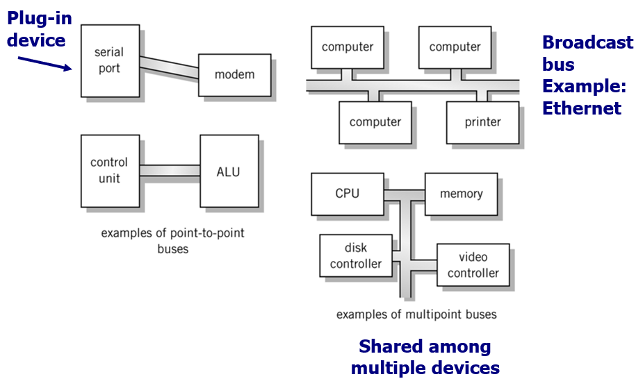
Point-to-point vs. Multipoint
The image you shared illustrates two types of communication bus systems: Point-to-Point and Multipoint buses. Let's break down each type with detailed explanations and additional examples.
1. Point-to-Point Bus
Definition: A point-to-point bus provides a dedicated communication link between two devices. It involves a direct connection where only two devices communicate with each other.
Examples:
Serial Port to Modem: This is a basic example where a computer's serial port connects directly to a modem. Only these two devices communicate, and no other device can use this connection.
Control Unit to Arithmetic Logic Unit (ALU): Inside a CPU, the control unit may have a direct, dedicated connection to the ALU for processing tasks. This is critical for efficient and direct processing within a CPU.

Slide 123
Characteristics:
Exclusive Communication: The bus is only shared between two devices.
No Contention: Since the connection is exclusive, there’s no need to manage contention for the bus.
Simple Protocols: Communication protocols can be simple because there's no need to manage multiple devices.
Other Examples:
USB Cable: In earlier versions, a USB device could be directly connected to a computer without sharing the connection with other devices.
FireWire: A high-speed interface that connects devices like cameras and hard drives directly to computers.
2. Multipoint Bus
Definition: A multipoint bus (also called a shared bus) is a communication system where multiple devices share a single communication channel or bus. This means several devices can send and receive data over the same physical connection.
Examples:
Ethernet (Broadcast Bus): In traditional Ethernet networks, multiple computers, printers, and other devices are connected to the same network. The data sent by one device can be seen by all other devices on the same bus. This is why it's called a "broadcast" network—data is shared by all connected devices.
CPU, Memory, Disk Controller, and Video Controller on a Shared Bus: In a computer system, multiple components like the CPU, memory, and peripherals may share a system bus, allowing them to communicate with one another over a shared medium.

Slide 124
Characteristics:
Shared Communication: The bus is shared by multiple devices, and only one device can communicate at a time.
Arbitration/Contention: A mechanism (often called bus arbitration) is needed to decide which device gets to use the bus when multiple devices want to communicate at the same time.
Efficiency: Shared buses can be more efficient in systems where devices communicate infrequently, but they may suffer from congestion if many devices need to communicate simultaneously.
Other Examples:
Peripheral Component Interconnect (PCI): In older computers, multiple hardware components like graphics cards and network cards shared the same PCI bus for communication with the CPU.
USB Hub: When multiple devices (e.g., keyboard, mouse, external storage) are connected to a single USB hub, they share the same communication channel to communicate with the computer.
3. Key Differences Between Point-to-Point and Multipoint Buses
Feature | Point-to-Point Bus | Multipoint Bus
Number of Devices | Only two devices can communicate directly. | Multiple devices can share the same bus for communication.
Contention | No contention (dedicated link). | Requires bus arbitration to avoid communication conflicts.
Cost | More expensive to implement, as each pair of devices needs its own connection. | Cheaper, as multiple devices can share the same bus.
Examples | Serial port to modem, CPU to ALU. | Ethernet network, CPU-memory-disk on a shared bus.
Communication Type | Exclusive, direct communication between two devices. | Shared communication where many devices may broadcast messages on the same bus.

Slide 125
4. Further Examples and Use Cases
Point-to-Point in Modern Systems:
PCI Express (PCIe): A modern example of point-to-point architecture, where each PCIe lane is a dedicated point-to-point connection between the CPU and a peripheral device (like a GPU or SSD). This results in very high performance as there’s no need to share bandwidth.
Multipoint in Communication Networks:
Wi-Fi: Although technically a wireless communication medium, Wi-Fi works on a shared broadcast medium similar to multipoint buses, where multiple devices contend for the ability to communicate over the same wireless channel.
Conclusion
Point-to-point buses are simple and fast but can be expensive and impractical when many devices need to communicate.
Multipoint buses allow many devices to share the same bus, making them more scalable and cost-efficient, but they introduce complexity in managing bus contention and ensuring smooth communication.

Slide 126
Classification of Instructions
Importance:
These are some of the most common and flexible instructions because they move data around different parts of the system.
Registers and memory are two types of storage:
Registers: Small, fast storage areas inside the CPU.
Memory: Larger storage area, slower than registers, and used to store a larger volume of data.
Example:
MOV A, B: Moves data from one register B to another register A. No actual computation is performed on the data, just relocation.
In a computer system, instruction sets define the operations a processor can perform. These instructions are typically divided into several categories based on their functionality. Below, we will go over Data Movement, Arithmetic, and Boolean Logic instructions in detail, along with examples and explanations of their importance.
1. Data Movement Instructions (Load, Store)
Definition: These instructions are used to transfer data between memory, registers, and sometimes input/output devices. They move data from one location to another without performing any operation on the data itself.
Common Operations:
Load: Moves data from memory to a register.
Example: LOAD R1, [1000] → This instruction loads the data from memory address 1000 into register R1.
Store: Moves data from a register to memory.
Example: STORE R1, [2000] → This instruction stores the data from register R1 into memory address 2000.

Slide 127
2. Word Size: 16, 32, or 64 bits?
Word size refers to the number of bits the CPU can process at one time. It affects how much data can be transferred in one operation and the size of registers.
16-bit: This means the processor can handle 16 bits of data at once (2 bytes). Common in older systems.
32-bit: Can handle 32 bits of data (4 bytes) at a time. Standard in many personal computers and laptops up until recent years.
64-bit: Most modern processors are 64-bit, meaning they can process 8 bytes (64 bits) of data in one operation. This allows the processor to work with larger chunks of data and increases memory addressing space, improving performance.
Example:
Load Word (LW) instruction on a 32-bit system loads 4 bytes from memory into a register.
On a 64-bit system, a "word" is 8 bytes.
3. Arithmetic Instructions
Definition: Arithmetic instructions perform mathematical operations on integers and floating-point numbers.
Operators:
Addition (+): Adds two values.
Example: ADD R1, R2, R3 → Adds the values in registers R2 and R3 and stores the result in R1.
Subtraction (-): Subtracts one value from another.
Example: SUB R1, R2, R3 → Subtracts the value in R3 from R2 and stores the result in R1.
Multiplication (*): Multiplies two values.
Example: MUL R1, R2, R3 → Multiplies R2 by R3 and stores the result in R1.
Division (/): Divides one value by another.
Example: DIV R1, R2, R3 → Divides R2 by R3 and stores the result in R1.

Slide 128
Types:
Integer Arithmetic: Deals with whole numbers.
Example: Adding two integers like 5 + 3 = 8.
Floating-Point Arithmetic: Deals with real numbers, which include decimals.
Example: Adding two floating-point numbers like 3.14 + 2.72 = 5.86.
Importance:
Arithmetic instructions are essential for any kind of computation, from simple addition and subtraction to complex mathematical algorithms.
4. Boolean Logic Instructions
Definition: Boolean logic instructions perform logical operations that follow Boolean algebra rules. These instructions are fundamental in decision-making and control flow within programs.
Common Operators:
AND: Bitwise AND operation.
Example: AND R1, R2, R3 → Performs a bitwise AND between the contents of R2 and R3, and stores the result in R1.
XOR: Bitwise exclusive OR (XOR) operation.
Example: XOR R1, R2, R3 → Performs an XOR between R2 and R3, and stores the result in R1.
NOT: Inverts the bits of a register.
Example: NOT R1, R2 → Inverts all the bits in R2 and stores the result in R1.
Importance:
Boolean logic operations are crucial for making comparisons and decisions in code. They help in the creation of conditions like if, else, while, and for statements in programming languages.

Slide 129
Examples:
Bitwise AND: 1010 AND 1100 = 1000
Bitwise XOR: 1010 XOR 1100 = 0110
NOT: NOT 1010 = 0101
5. Single Operand Manipulation Instructions
Definition: These are instructions that operate on only one operand, often used to modify a value in a simple way (e.g., incrementing or negating a number).
Types of Single Operand Instructions:
Negation (NEG): Negates the value in a register.
Example: NEG R1 → If R1 contains 5, after this operation, R1 will contain -5.
Increment (INC): Increases the value in a register by 1.
Example: INC R1 → If R1 contains 5, after this operation, R1 will contain 6.
Decrement (DEC): Decreases the value in a register by 1.
Example: DEC R1 → If R1 contains 5, after this operation, R1 will contain 4.
Set to Zero: Sets the value of a register to 0.
Example: CLR R1 → This instruction will set the value in R1 to 0.

Slide 130
Importance:
These instructions are used for loop counters, value resetting, and optimization in algorithms. Increment and decrement instructions are common in loops where variables are repeatedly increased or decreased.
Conclusion
Each type of instruction serves a specific purpose in computing:
Data Movement Instructions are crucial for transferring data between memory and CPU registers.
Arithmetic Instructions perform the basic computations that drive most of the processing in the system.
Boolean Logic Instructions enable decision-making and condition handling in programs.
Single Operand Instructions offer efficient ways to perform small but frequent operations like incrementing, negating, or resetting values.
Together, these instructions form the backbone of how modern processors execute tasks and manipulate data. Understanding their classification helps in designing efficient algorithms and understanding low-level hardware operations.

Slide 131
More Instruction Classifications
In computer architecture, instruction sets are further classified based on specific operations they perform, beyond basic arithmetic, data movement, and logic. Here, we will explore bit manipulation, flags and condition testing, shifting and rotating, program control, stack management, multiple data handling, and I/O and machine control instructions, with detailed explanations and examples.
1. Bit Manipulation Instructions
Definition: Bit manipulation instructions operate on individual bits of data within registers or memory locations. These instructions allow fine control over the binary representation of data.
Common Operations:
Set Bit: Sets a particular bit to 1.
Example: SETB R1, 2 → This sets the 2nd bit of the value in R1 to 1.
Clear Bit: Clears a particular bit (sets it to 0).
Example: CLRB R1, 3 → Clears the 3rd bit of R1.
Toggle Bit: Flips a specific bit (1 becomes 0, 0 becomes 1).
Example: TGLB R1, 4 → Toggles the 4th bit of R1.
Importance:
Bit manipulation instructions are highly efficient for tasks such as setting or clearing flags, masking, and performing low-level optimization in cryptography or compression algorithms.
Example:
In embedded systems, turning on or off individual components (e.g., LEDs, motors) often involves manipulating specific bits in control registers.

Slide 132
2. Flags and Condition Testing Instructions
Definition: These instructions test the result of previous operations and set flags (special bits in a status register) accordingly. These flags can then be tested to decide the flow of control (such as branching).
Common Flags:
Zero Flag (ZF): Set if the result of an operation is zero.
Carry Flag (CF): Set if an arithmetic operation generates a carry out of the most significant bit.
Overflow Flag (OF): Set if signed arithmetic results in overflow.
Sign Flag (SF): Indicates if the result of an operation is positive or negative.
Conditional Testing:
CMP (Compare): Compares two values by subtracting one from the other and sets flags accordingly (without saving the result).
Example: CMP R1, R2 → Subtracts R2 from R1 and sets flags based on the result (e.g., if R1 == R2, the zero flag is set).
TEST: Performs a bitwise AND of two values and sets the zero flag if the result is zero.
Example: TEST R1, R2 → Checks if the bits in R1 and R2 match and updates the flags.
Importance:
Condition flags are critical for decision-making in programs (e.g., checking whether a loop should continue or a branch should be taken).

Slide 133
3. Shift and Rotate Instructions
Definition: These instructions move the bits of a value left or right, potentially wrapping bits around (in the case of rotation). Shifting and rotating are commonly used in low-level mathematical operations, cryptography, and data alignment.
Common Operations:
Shift Left Logical (SLL): Shifts the bits of a register left by a specified number of positions, filling the rightmost positions with zeros.
Example: SLL R1, 2 → Shifts the bits of R1 two positions to the left, padding the right with zeros.
Shift Right Arithmetic (SRA): Shifts the bits to the right while maintaining the sign (most significant bit remains unchanged for signed values).
Example: SRA R1, 1 → Shifts the bits of R1 one position to the right while keeping the sign.
Rotate Left (ROL): Rotates bits to the left, wrapping the leftmost bit to the rightmost position.
Example: ROL R1, 1 → Rotates the bits of R1 left by 1, moving the leftmost bit to the right.
Importance:
Shifts can be used for multiplication or division by powers of two.
Rotates are useful in cryptographic algorithms and data encoding.
Example:
Shift Left: Shifting 1101 left by 1 becomes 1010, which can be equivalent to multiplying by 2 in binary.

Slide 134
4. Program Control Instructions
Definition: Program control instructions manage the flow of execution in a program. These instructions include branching, jumping, and halting operations.
Common Operations:
Jump (JMP): Transfers control to another part of the program by changing the program counter.
Example: JMP 0x0040 → Jump to memory location 0x0040 and continue execution from there.
Branch if Zero (BEQ): Branches to a new instruction location if the zero flag is set.
Example: BEQ 0x0080 → If the previous operation resulted in zero, jump to location 0x0080.
Call: Calls a subroutine, saving the return address on the stack.
Example: CALL 0x00A0 → Jump to subroutine at 0x00A0 and store the return address for later.
Importance:
Control flow instructions are crucial for implementing loops, conditionals, function calls, and handling exceptions or interrupts in a program.

Slide 135
5. Stack Instructions
Definition: Stack instructions operate on the stack, a data structure used for storing data temporarily, such as return addresses, local variables, and function parameters. The stack is managed using a Last In, First Out (LIFO) principle.
Common Operations:
Push: Places a value onto the top of the stack.
Example: PUSH R1 → Pushes the contents of R1 onto the stack.
Pop: Removes a value from the top of the stack and places it in a register.
Example: POP R1 → Pops the top value from the stack into R1.
Call/Return: CALL pushes the current program counter to the stack before jumping to a subroutine, and RET pops the program counter from the stack to return from the subroutine.
Importance:
Stack instructions are essential for subroutine calls, interrupt handling, and recursive function support.

Slide 136
6. Multiple Data Instructions
Definition: These instructions operate on multiple pieces of data at the same time, often using vector or SIMD (Single Instruction, Multiple Data) operations to improve performance, particularly in multimedia processing and scientific computation.
Common Operations:
Load Multiple (LDM): Loads multiple values from memory into a set of registers.
Example: LDM R1-R4, [1000] → Loads four consecutive memory locations starting at address 1000 into registers R1, R2, R3, and R4.
Store Multiple (STM): Stores multiple register values into consecutive memory locations.
Example: STM [2000], R1-R4 → Stores the values in registers R1 to R4 in consecutive memory locations starting at 2000.
Importance:
Multiple data instructions are key to improving efficiency in operations involving arrays, matrices, and graphics.
Example:
SIMD: In modern CPUs, a single instruction can perform the same operation (e.g., addition) on several data points simultaneously, which speeds up tasks like image processing or matrix multiplication.

Slide 137
7. I/O and Machine Control Instructions
Definition: These instructions manage communication between the CPU and external devices (input/output), as well as control the internal state of the processor.
Common Operations:
IN: Reads data from an I/O port into a register.
Example: IN R1, 0xFF → Reads data from I/O port 0xFF into register R1.
OUT: Writes data from a register to an I/O port.
Example: OUT 0xFF, R1 → Writes the contents of R1 to I/O port 0xFF.
HALT: Stops the processor from executing instructions.
Example: HALT → Halts the system, stopping execution until a reset or interrupt occurs.
Interrupt: Causes the CPU to stop its current execution and handle an external event.
Example: INT 0x80 → Causes an interrupt, which triggers the interrupt service routine.
Importance:
I/O instructions are essential for interacting with external devices like keyboards, displays, and storage devices.
Machine control instructions like HALT and Interrupt are used for power management and to handle external signals or exceptions.
Conclusion
These additional instruction classifications provide more advanced functionality for managing data, controlling program flow, and interacting with hardware. Each set of instructions plays a key role in making modern processors versatile and capable of performing a wide range of tasks efficiently.
Bit manipulation gives low-level control over data.
Flags and condition testing help determine execution flow.
Shifting and rotating optimize arithmetic and cryptographic operations.
Program control manages the order in which instructions are executed.
Stack instructions support subroutines and recursive processes.
Multiple data instructions improve performance in operations requiring simultaneous data handling.
I/O and machine control facilitate communication between the CPU and the outside world.

Slide 138
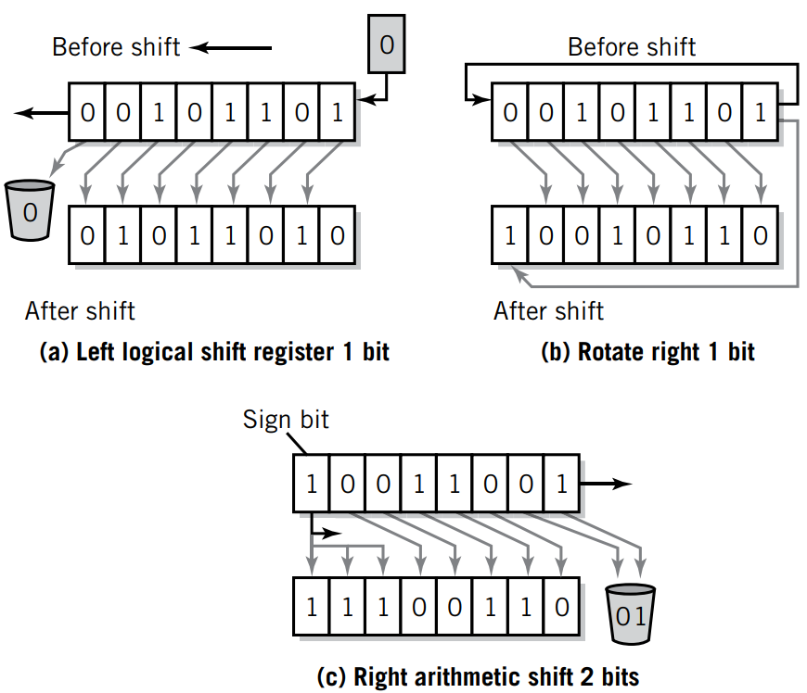
Register Shifts & Rotates
The image depicts different types of shift and rotate operations, which are essential in computer systems, particularly for data manipulation, bitwise operations, and optimizing arithmetic processes. Below is a detailed explanation of each type of shift and rotate, including real-world examples and use cases.
1. Left Logical Shift (LLS) - Figure a
In a Left Logical Shift operation, the bits of the register are shifted left by a specified number of positions. The empty positions on the right are filled with zeros, and the leftmost bit (MSB) is discarded.
Operation:
The entire binary sequence is shifted left by 1 bit.
A 0 is inserted into the rightmost bit position (least significant bit, LSB).
The leftmost bit is discarded, effectively "shifted out."
Example (Left Shift by 1):
Before Shift: 00101101
After Shift: 01011010

Slide 139
Use Case:
Multiplication by Powers of Two: A left logical shift by 1 bit is equivalent to multiplying the binary number by 2.
Example: Shifting 0011 (which is 3 in decimal) left by 1 gives 0110 (which is 6 in decimal, equivalent to 3 * 2).
General Form:
Shift Left Logical (SLL R1, 1) → Shifts the contents of register R1 to the left by 1 bit.
2. Rotate Right (ROR) - Figure b
A Rotate Right operation moves the bits of the register to the right, but instead of discarding the rightmost bit, it is wrapped around and placed in the leftmost position (MSB).
Operation:
The bits are rotated right by 1 bit.
The rightmost bit is "rotated" back into the leftmost position.
Example (Rotate Right by 1):
Before Rotate: 00101101
After Rotate: 10010110
Use Case:
Cryptographic Algorithms: Rotate operations are widely used in encryption algorithms like AES (Advanced Encryption Standard) and DES (Data Encryption Standard) where circular shifts ensure that bits are not discarded but simply rearranged.
General Form:
Rotate Right (ROR R1, 1) → Rotates the contents of register R1 to the right by 1 bit.

Slide 140
3. Right Arithmetic Shift (RAS) - Figure c
In a Right Arithmetic Shift, the bits of the register are shifted right by a specified number of positions, but the sign bit (MSB) is preserved, meaning the leftmost bit is replicated to preserve the sign of the number (especially for signed integers).
Operation:
The binary sequence is shifted right by 2 bits.
The leftmost (sign) bit is preserved and repeated as bits shift to the right.
The rightmost bits are discarded.
Example (Right Arithmetic Shift by 2):
Before Shift: 10101101 (assuming a signed 8-bit integer, this represents -83 in two's complement notation)
After Shift: 11101011 (after shifting right by 2 bits, it becomes -21 in two's complement)
Use Case:
Division by Powers of Two: A right arithmetic shift is equivalent to dividing a signed binary number by 2.
Example: Shifting 1100 (which is -4 in two’s complement) right by 1 gives 1110 (which is -2, equivalent to -4 / 2).
General Form:
Shift Right Arithmetic (SRA R1, 2) → Shifts the contents of register R1 to the right by 2 bits, preserving the sign bit.

Slide 141
4. Key Differences Between Shifts and Rotates
Shifts: Shift operations discard bits (e.g., logical shifts fill the vacated bits with zeros, and arithmetic shifts preserve the sign bit).
Rotates: In rotate operations, bits that would otherwise be discarded are wrapped around and placed in the vacated bit positions (i.e., no bits are lost).
Conclusion
Shift and rotate operations are fundamental tools in computer architecture for manipulating data at the bit level. They are used in a wide range of applications, including arithmetic operations, cryptography, and low-level programming. Understanding how each operation behaves is crucial for optimizing performance, especially in hardware-level programming, embedded systems, and algorithm design.
5. Examples of When to Use
Left Logical Shift (LLS):
Efficient for multiplication by powers of two.
Used in bit-level graphics manipulation (e.g., moving pixels left or right).
Rotate Right (ROR):
Useful in encryption algorithms where bit positions are shifted without losing information.
Helpful in circular buffer management where data wraps around.
Right Arithmetic Shift (RAS):
Ideal for signed division by powers of two (e.g., dividing a signed integer by 2 while maintaining its sign).
Frequently used in fixed-point arithmetic for mathematical operations involving signed numbers.

Slide 142
Quick Review Questions
Process: During this phase, the CPU reads the next instruction from memory, as indicated by the Program Counter (PC), and loads it into the Instruction Register (IR). Steps:
The Program Counter (PC) holds the memory address of the next instruction.
The CPU reads the instruction from that address in memory and stores it in the Instruction Register (IR).
The PC is incremented to point to the next instruction in memory.
Why the Fetch Phase is the Same for Every Instruction:
Regardless of the complexity of the instruction (e.g., arithmetic, logical, branching), the first step is always fetching the instruction from memory to prepare for execution.
Question 1: The instruction cycle is divided into two phases. Name each phase. The first phase is the same for every instruction. What is the purpose of the first phase that makes this true?
Answer:
The instruction cycle is the basic operational process of a computer. It is divided into two primary phases:
Fetch Phase
Execute Phase
Fetch Phase
Purpose: The fetch phase retrieves an instruction from memory so it can be executed. This phase is consistent for all instructions because every instruction must be fetched from memory before it can be executed.

Slide 143
Execute Phase
Purpose: The execute phase performs the operation specified by the fetched instruction. The exact process varies depending on the instruction type (e.g., addition, moving data, conditional jumps).
Example:
If the instruction is an addition (ADD), the CPU fetches the operands, performs the addition, and stores the result in a register or memory.
Question 2: What are the criteria that define a von Neumann architecture? How does the addition of two numbers illustrate each of the criteria?
Answer:
The von Neumann architecture is a design model for modern computers that defines how data and instructions are stored and processed. It is based on the following criteria:
Single Memory for Data and Instructions:
Both program instructions and data are stored in the same memory space.
Example: When adding two numbers, both the instruction to add and the numbers to be added are fetched from the same memory.
Stored Program Concept:
The instructions of a program are stored in memory alongside the data they operate on.
Example: To add two numbers, the instruction for addition (e.g., ADD A, B) is stored in memory and is executed by fetching it from memory.

Slide 144
Sequential Instruction Processing:
Instructions are processed one after another in a sequential manner unless explicitly directed otherwise (via jumps or branches).
Example: The CPU fetches the addition instruction, processes it, and then moves to the next instruction.
Control Unit:
The control unit fetches and decodes instructions and directs the operation of the ALU, memory, and I/O.
Example: The control unit fetches the addition instruction, identifies it as an addition operation, and signals the Arithmetic Logic Unit (ALU) to perform the addition.
Illustrating the von Neumann Architecture with Addition:
The instruction and the numbers to be added are fetched from the same memory.
The instruction is stored in memory along with data.
Instructions are processed in a sequential order, starting with fetching the next instruction.
The control unit fetches the instruction, decodes it, and signals the CPU to execute the addition.
Question 3: What is the difference between volatile and nonvolatile memory? Is RAM volatile or nonvolatile? Is ROM volatile or nonvolatile?
Answer:
Memory in a computer is either volatile or nonvolatile, depending on whether or not it retains its data when the power is turned off.
Volatile Memory
Volatile memory loses its contents when the power is turned off.
RAM (Random Access Memory) is a prime example of volatile memory.
RAM holds the data and instructions that the CPU is currently processing. When the computer is shut down, all data in RAM is lost.
Example:
If you're typing a document in a word processor, the contents are stored in RAM while you're working on it. If the computer suddenly loses power, the unsaved work is lost because RAM is volatile.

Slide 145
Nonvolatile Memory
Nonvolatile memory retains its contents even when the power is turned off.
ROM (Read-Only Memory) is an example of nonvolatile memory. ROM typically stores firmware or the computer's BIOS (Basic Input/Output System), which persists even when the computer is powered off.
Example:
When you power on your computer, the BIOS stored in ROM is executed first to initiate hardware checks and start the boot process.
Question 4: Registers perform a very important role in the fetch-execute cycle. What is the function of registers in the fetch-execute instruction cycle?
Answer:
Registers are small, high-speed storage locations in the CPU that temporarily hold data and instructions. They play a critical role in the fetch-execute cycle by holding key pieces of information that are used in processing instructions.
Key Registers in the Fetch-Execute Cycle:
Program Counter (PC):
Holds the address of the next instruction to be fetched from memory.
Instruction Register (IR):
Holds the fetched instruction that is currently being decoded and executed.
Memory Address Register (MAR):
Holds the memory address from which data or instructions are to be fetched.
Memory Data Register (MDR):
Holds the actual data fetched from memory.
Accumulator (ACC) or General-Purpose Registers:
Temporarily hold data being used in the current instruction.

Slide 146
Question 5: Explain each of the fetch part of the fetch-execute cycle. At the end of the fetch operation, what is the status of the instruction? Specifically, what has the fetch operation achieved that prepares the instruction for execution?
Answer:
The fetch operation is the first part of the fetch-execute cycle. Its purpose is to retrieve the next instruction to be executed from memory. The CPU repeats this cycle continuously as it processes a program.
Fetch Cycle Steps:
Program Counter (PC) Check:
The CPU looks at the PC to determine the memory address of the next instruction.
MAR Update:
The address from the PC is loaded into the Memory Address Register (MAR).
Instruction Fetch:
The CPU sends the address stored in the MAR to memory, where the instruction is located. The instruction is fetched from memory and stored in the Memory Data Register (MDR).
Instruction Register Update:
The fetched instruction in the MDR is moved to the Instruction Register (IR).
PC Increment:
The Program Counter (PC) is incremented so that it points to the next instruction in the program.
End of Fetch Operation:
At the end of the fetch operation, the instruction is stored in the IR, and the PC is ready for the next instruction. The CPU is now prepared to decode and execute the fetched instruction.

Slide 147
Question 6: Explain the similarity between this operation and the corresponding operation performed steps performed by the Little Man.
Answer:
The Little Man Computer (LMC) is a simplified instructional model used to teach basic CPU operations. The fetch part of the cycle in LMC closely mirrors that of real CPUs.
LMC Fetch Operation:
Mailbox Address: The little man looks at the instruction counter (equivalent to the PC in a real CPU) to find the address of the next instruction.
Mailbox Check: The little man goes to the mailbox (memory) corresponding to that address.
Instruction Fetch: He retrieves the instruction (e.g., ADD 6) and writes it down on the notepad (IR).
Counter Update: The little man then increments the instruction counter to prepare for the next instruction.
Similarities:
In both LMC and a real CPU, the program counter (or instruction counter in LMC) holds the address of the next instruction.
The CPU or the little man fetches the instruction from memory.
The PC/instruction counter is incremented to point to the next instruction after fetching.
This analogy helps to illustrate the core concepts of instruction fetching and the fetch-execute cycle in a simple, understandable manner.

Slide 148
Conclusion
The instruction cycle is divided into two main phases: fetch (same for all instructions) and execute (varies based on the instruction).
The von Neumann architecture relies on principles such as a shared memory for data and instructions, sequential execution, and control through a control unit.
Volatile memory (like RAM) loses data when the power is off, while nonvolatile memory (like ROM) retains data.
Registers play a critical role in storing temporary data and managing addresses during the fetch-execute cycle.
The fetch phase retrieves the next instruction from memory and places it in the instruction register for execution.
The Little Man Computer (LMC) provides an intuitive analogy to explain how the fetch cycle works in a simplified manner.

